Slide 1
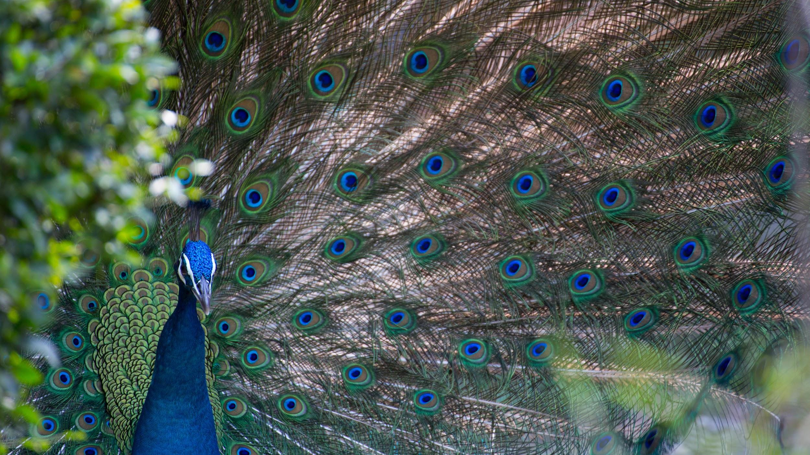
LINNAEAN CLASSIFICATION
We will use the Linnaean classification system to compare organisms.
Notes:
Insert cover image and use transparency settings to fade image.

Slide 2
Do not delete this slide.
This slide is designed so that you can copy the prompt box you need and insert it into your slides.
This slide is hidden and will not be included when presenting your lesson.
TRACK WITH ME
VOCABULARY
1 -
HINT
Students, remember….
CHECK FOR UNDERSTANDING
READ WITH ME
TEACHER CUE
MAKE THE CONNECTION
Students, you already know….
EXTENSION
GESTURE WITH ME

Slide 3
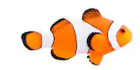
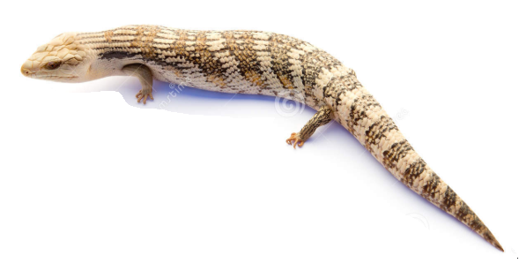
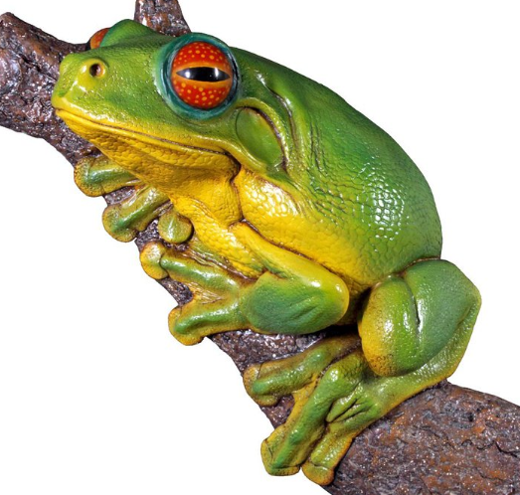
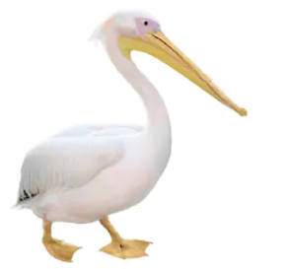
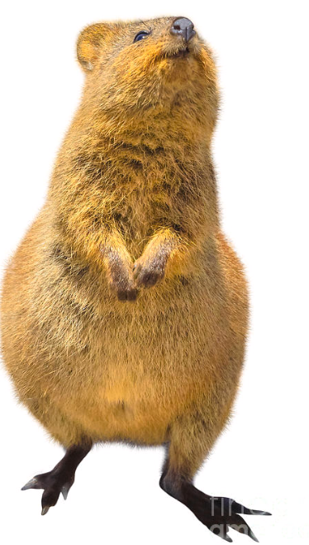
Match the observable features to the vertebrates below.
A: Clown Fish
D: Blue Tongue Lizard
Observable features
Feathers & beak
Hair/fur
Dry scales
Wet skin
Wet scales
B: Green Tree Frog
E: Pelican
C: Quokka

Slide 4
Repeat the opposite word/phrase.
ORGANISM
LIVING THING

Slide 5
Repeat the opposite word/phrase.
CLASSIFICATION
SORTING BY CHARACTERISTICS

Slide 6
Repeat the opposite word/phrase.
OBSERVABLE FEATURE
FEATURE YOU CAN SEE

Slide 7
Repeat the opposite word/phrase.
INVERTEBRATE
NO BACKBONE

Slide 8
Repeat the opposite word/phrase.
VERTEBRATE
HAS A BACKBONE

Slide 9
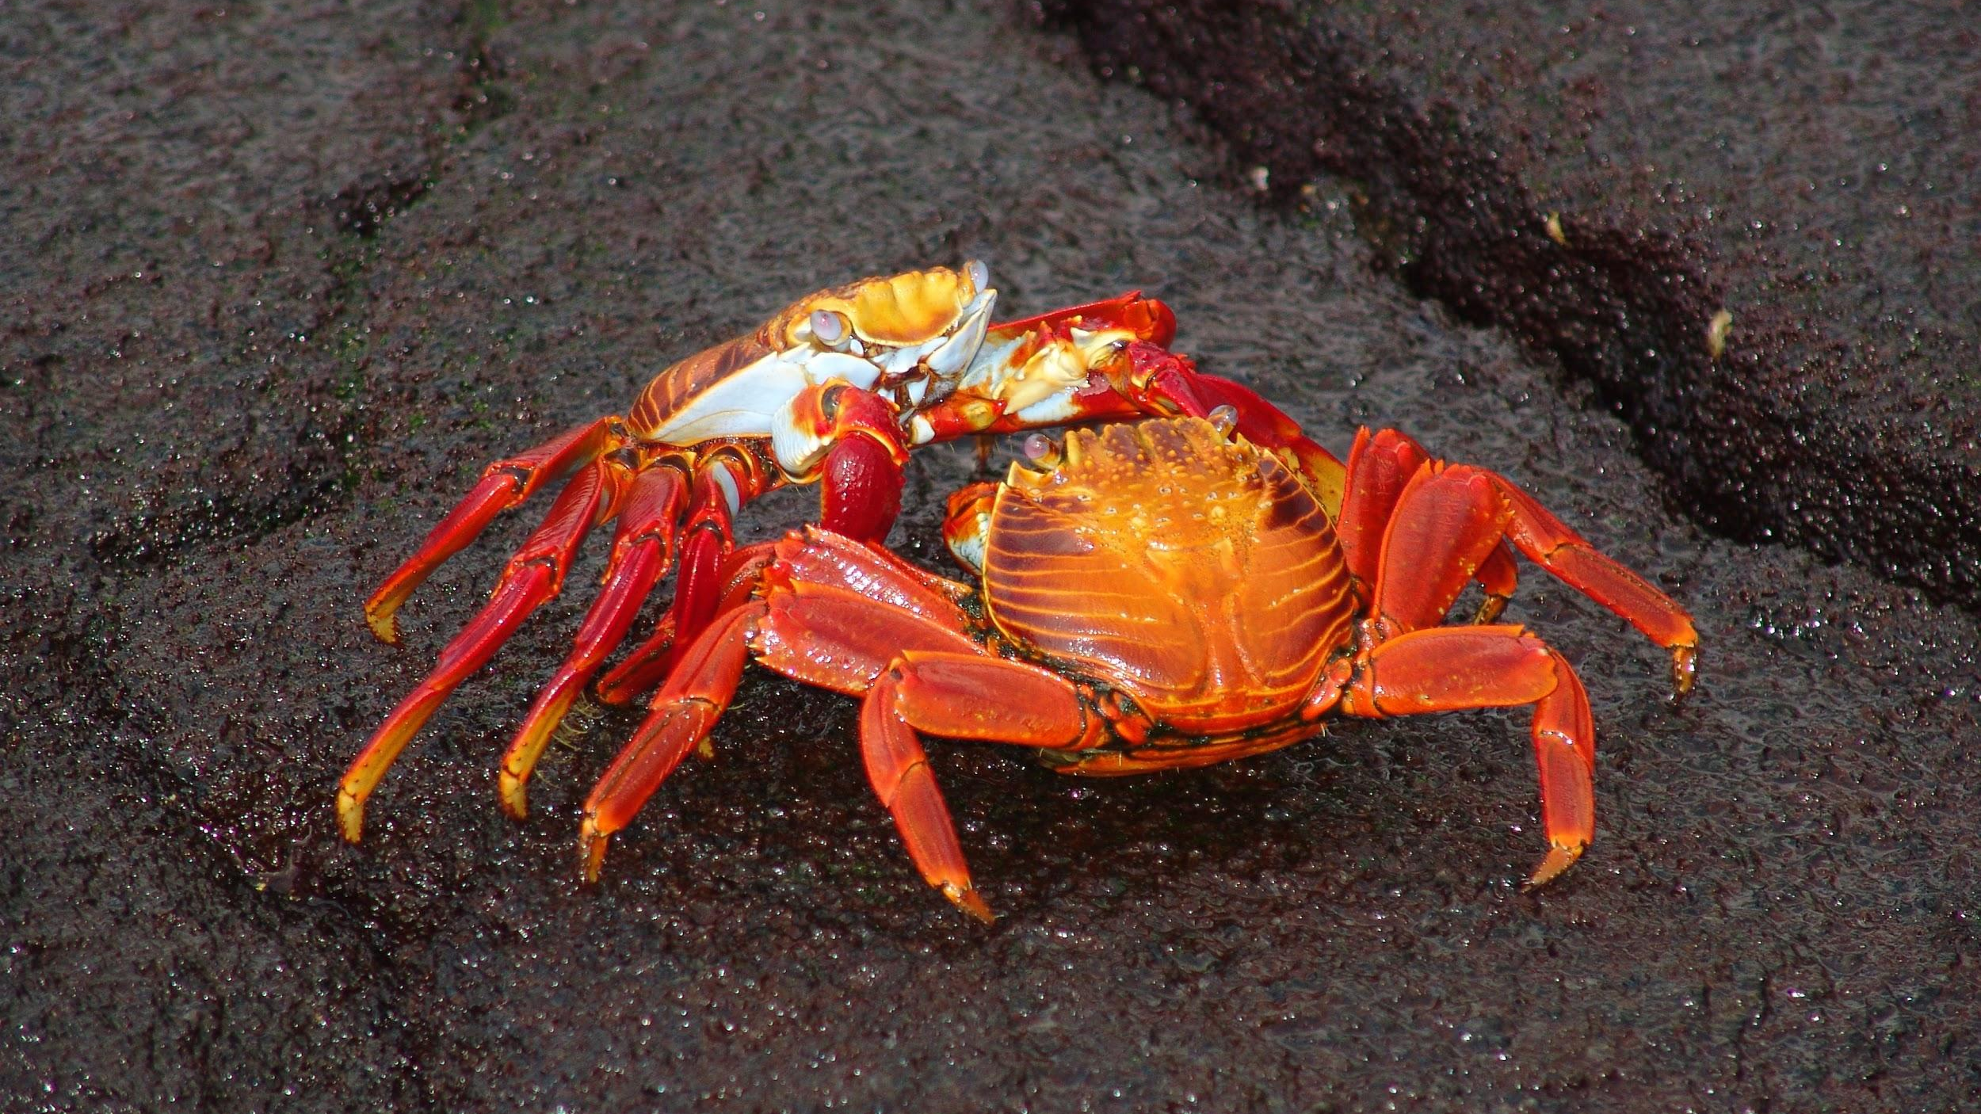
Repeat the opposite word/phrase.
EXOSKELETON
HARD BODY COVERING

Slide 10
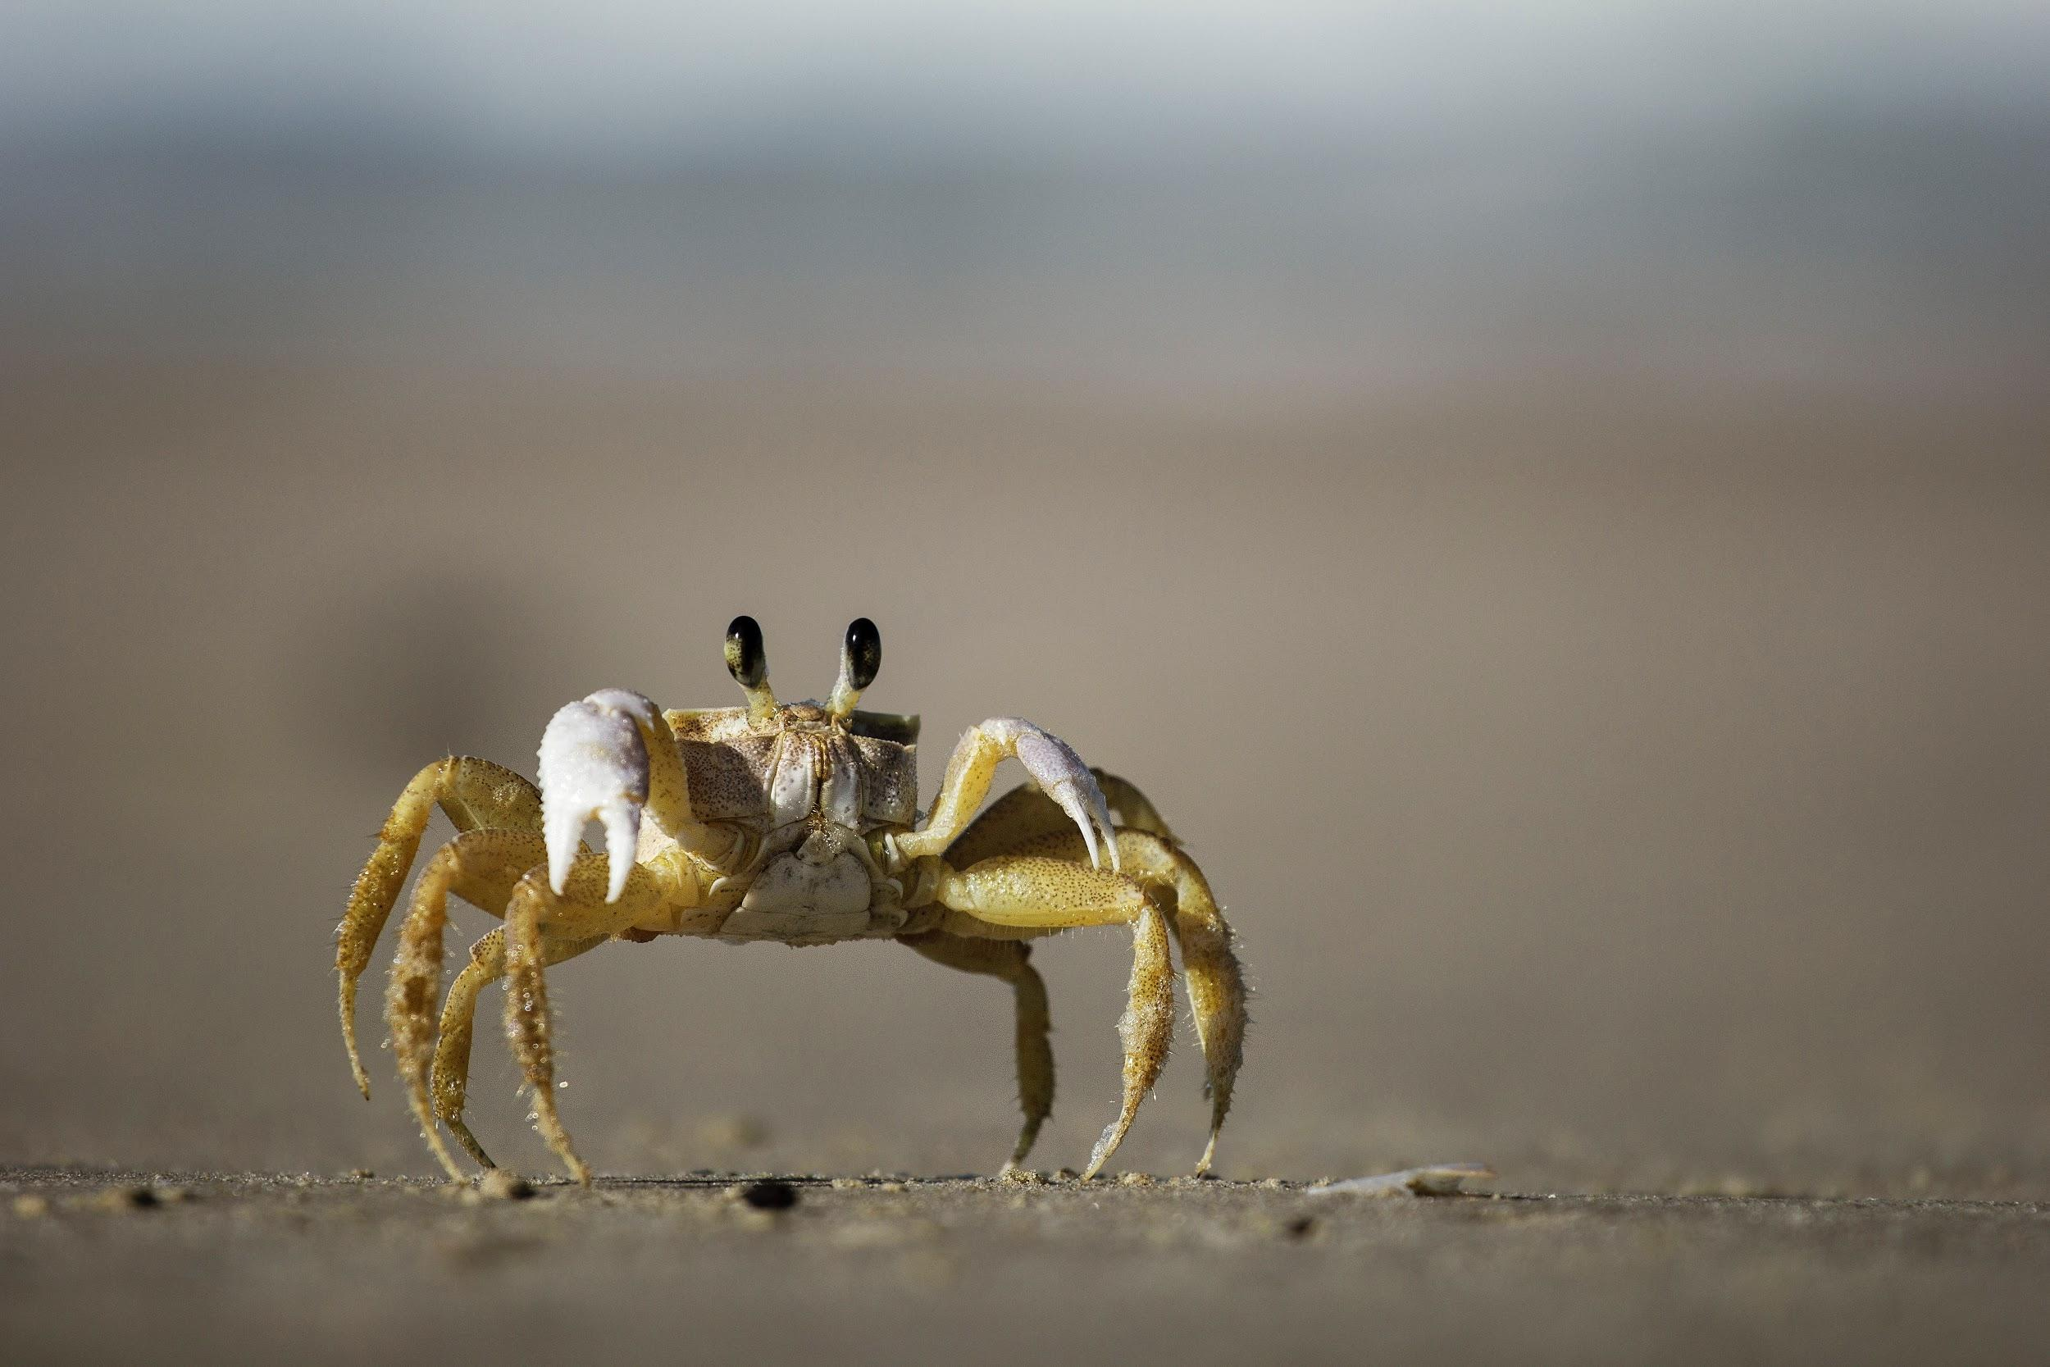
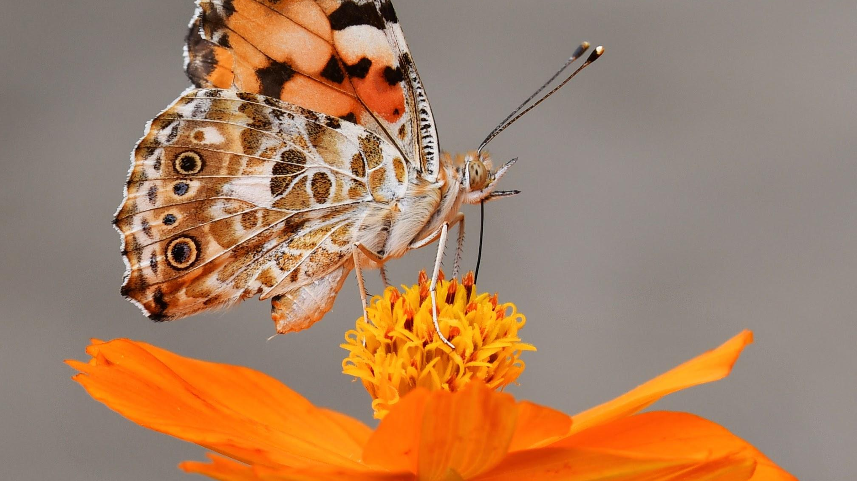
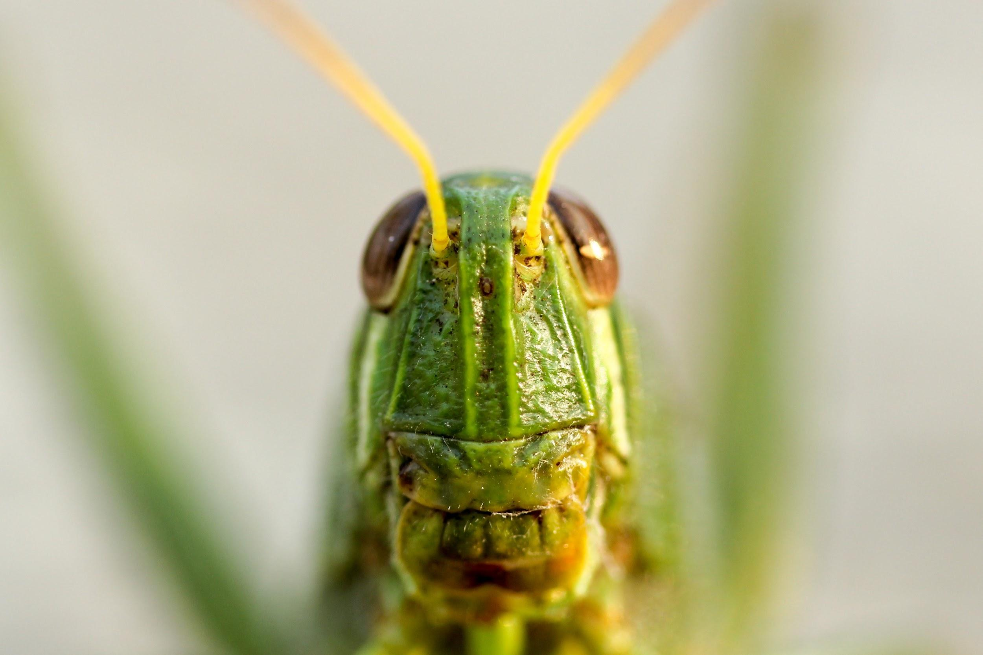
Repeat the opposite word/phrase.
ANTENNAE
FEELERS ON HEAD

Slide 11
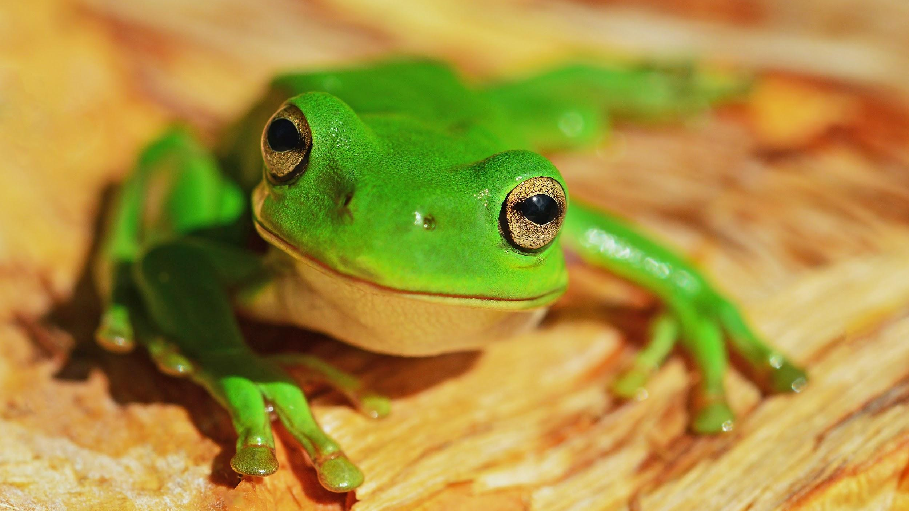
Is a frog living, non-living or dead?
Explain your answer using MRS GRENC
Move
Reproduce
Sensitive
Grow
Respire
Excrete wastes
Nutrition
Cells

Slide 12
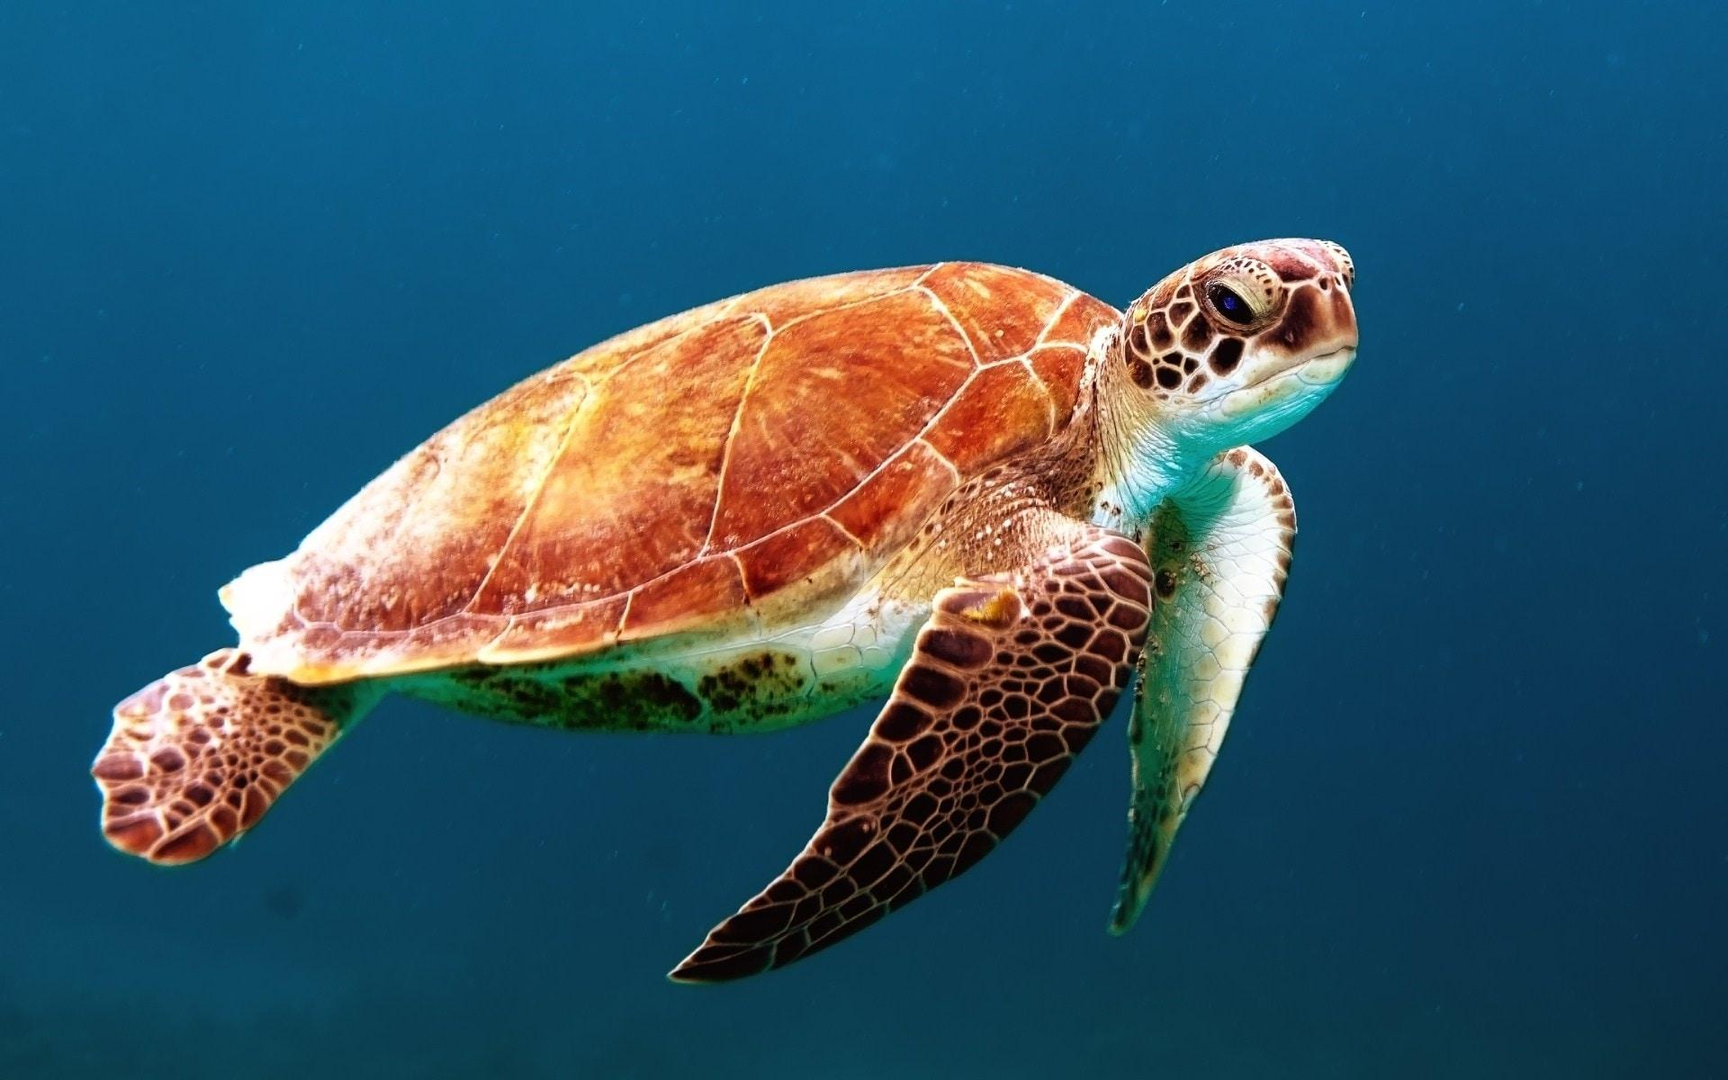
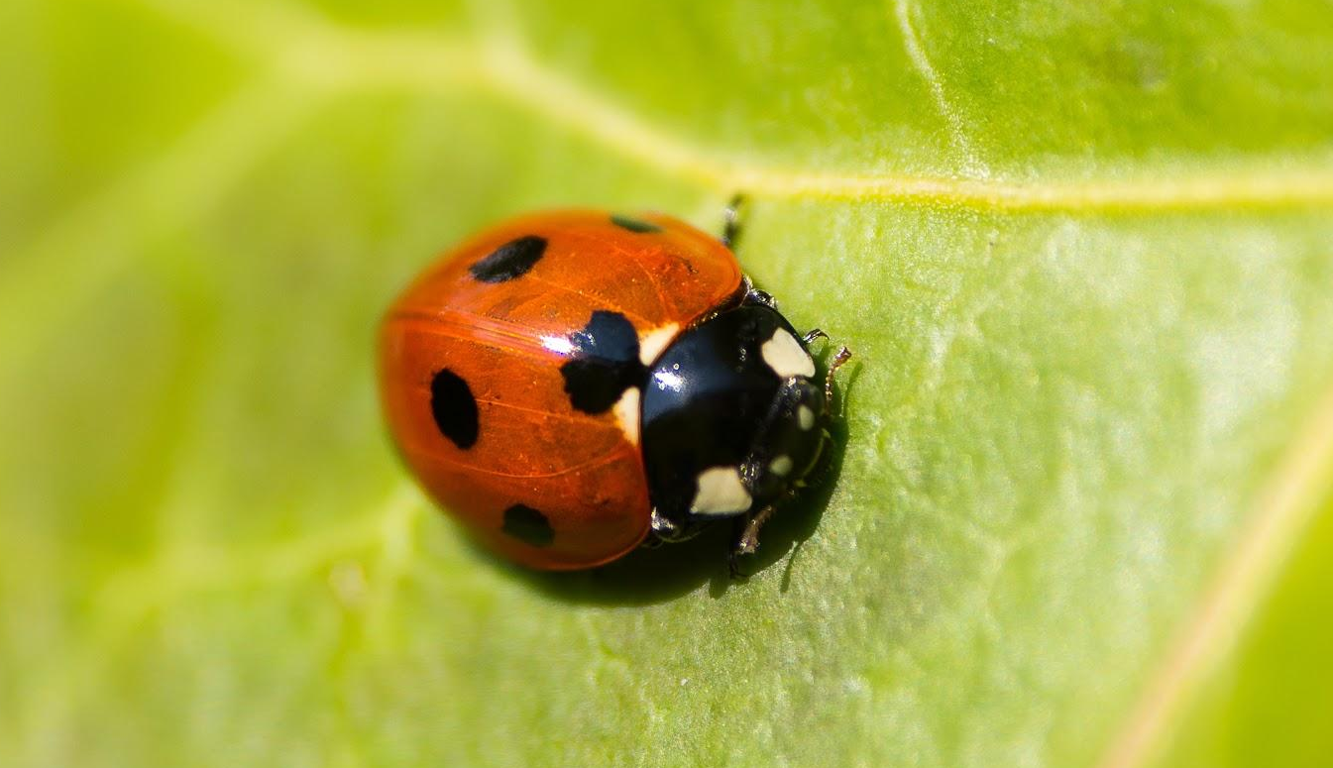
List the observable features of the turtle and lady-bug.
Turtle:
Lady-bug:

Slide 13
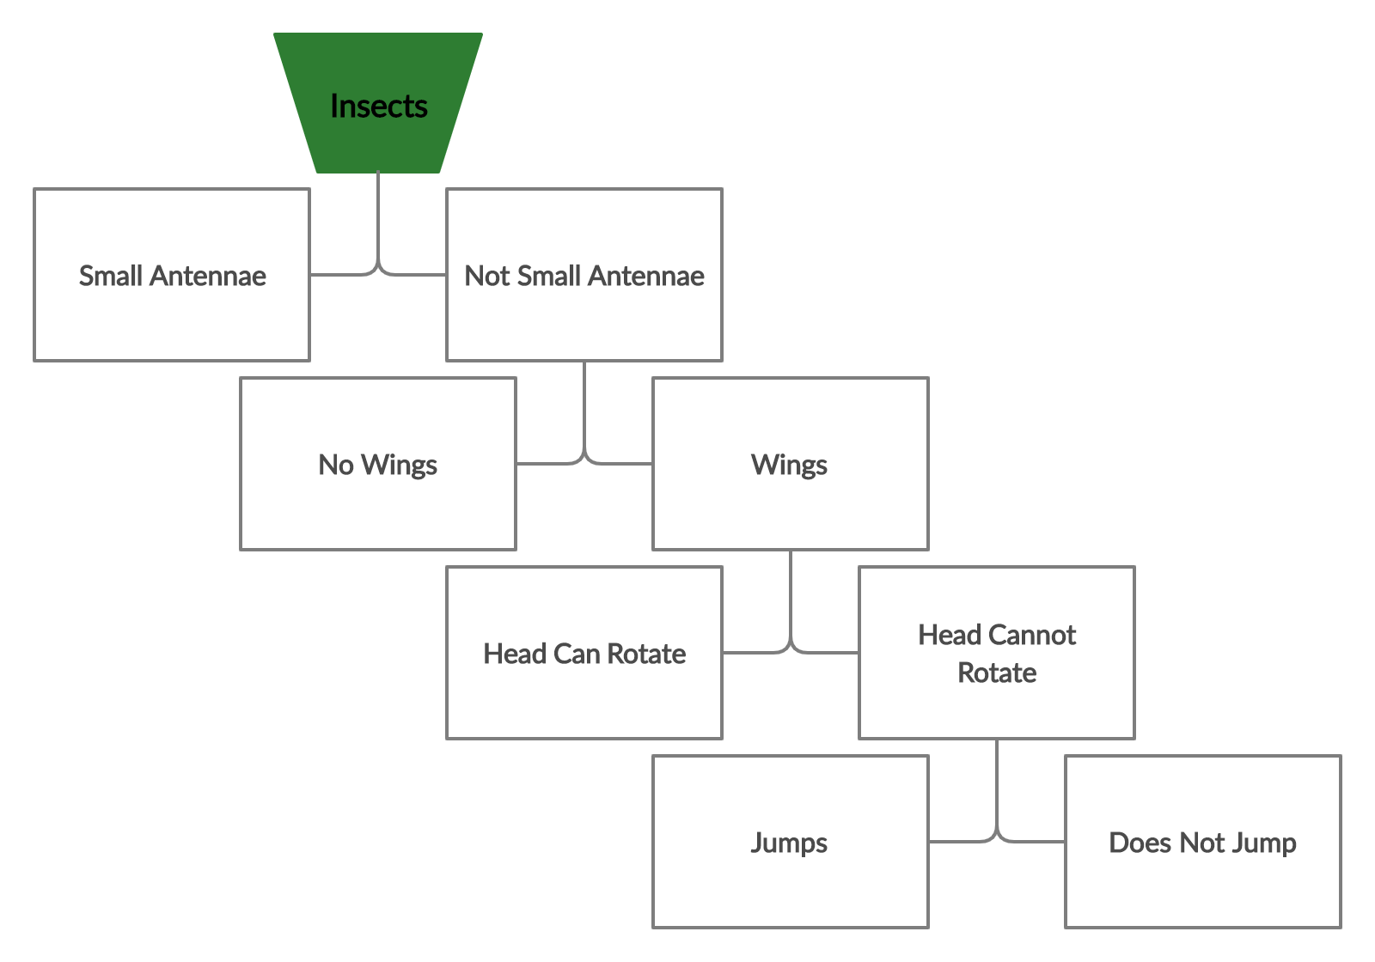
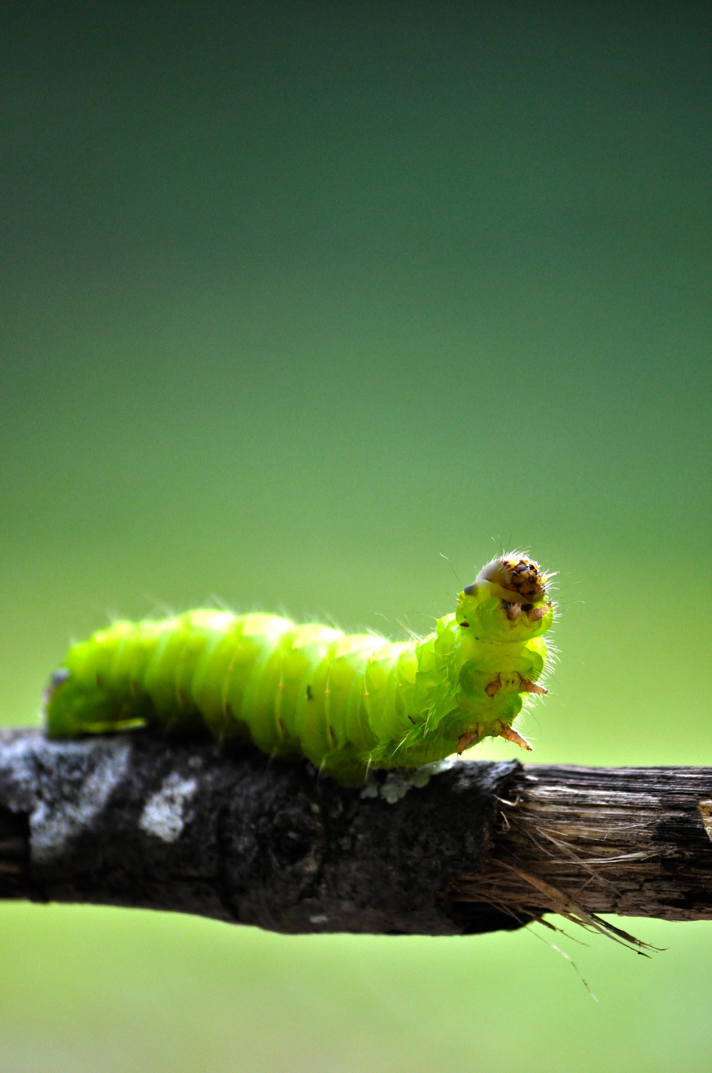
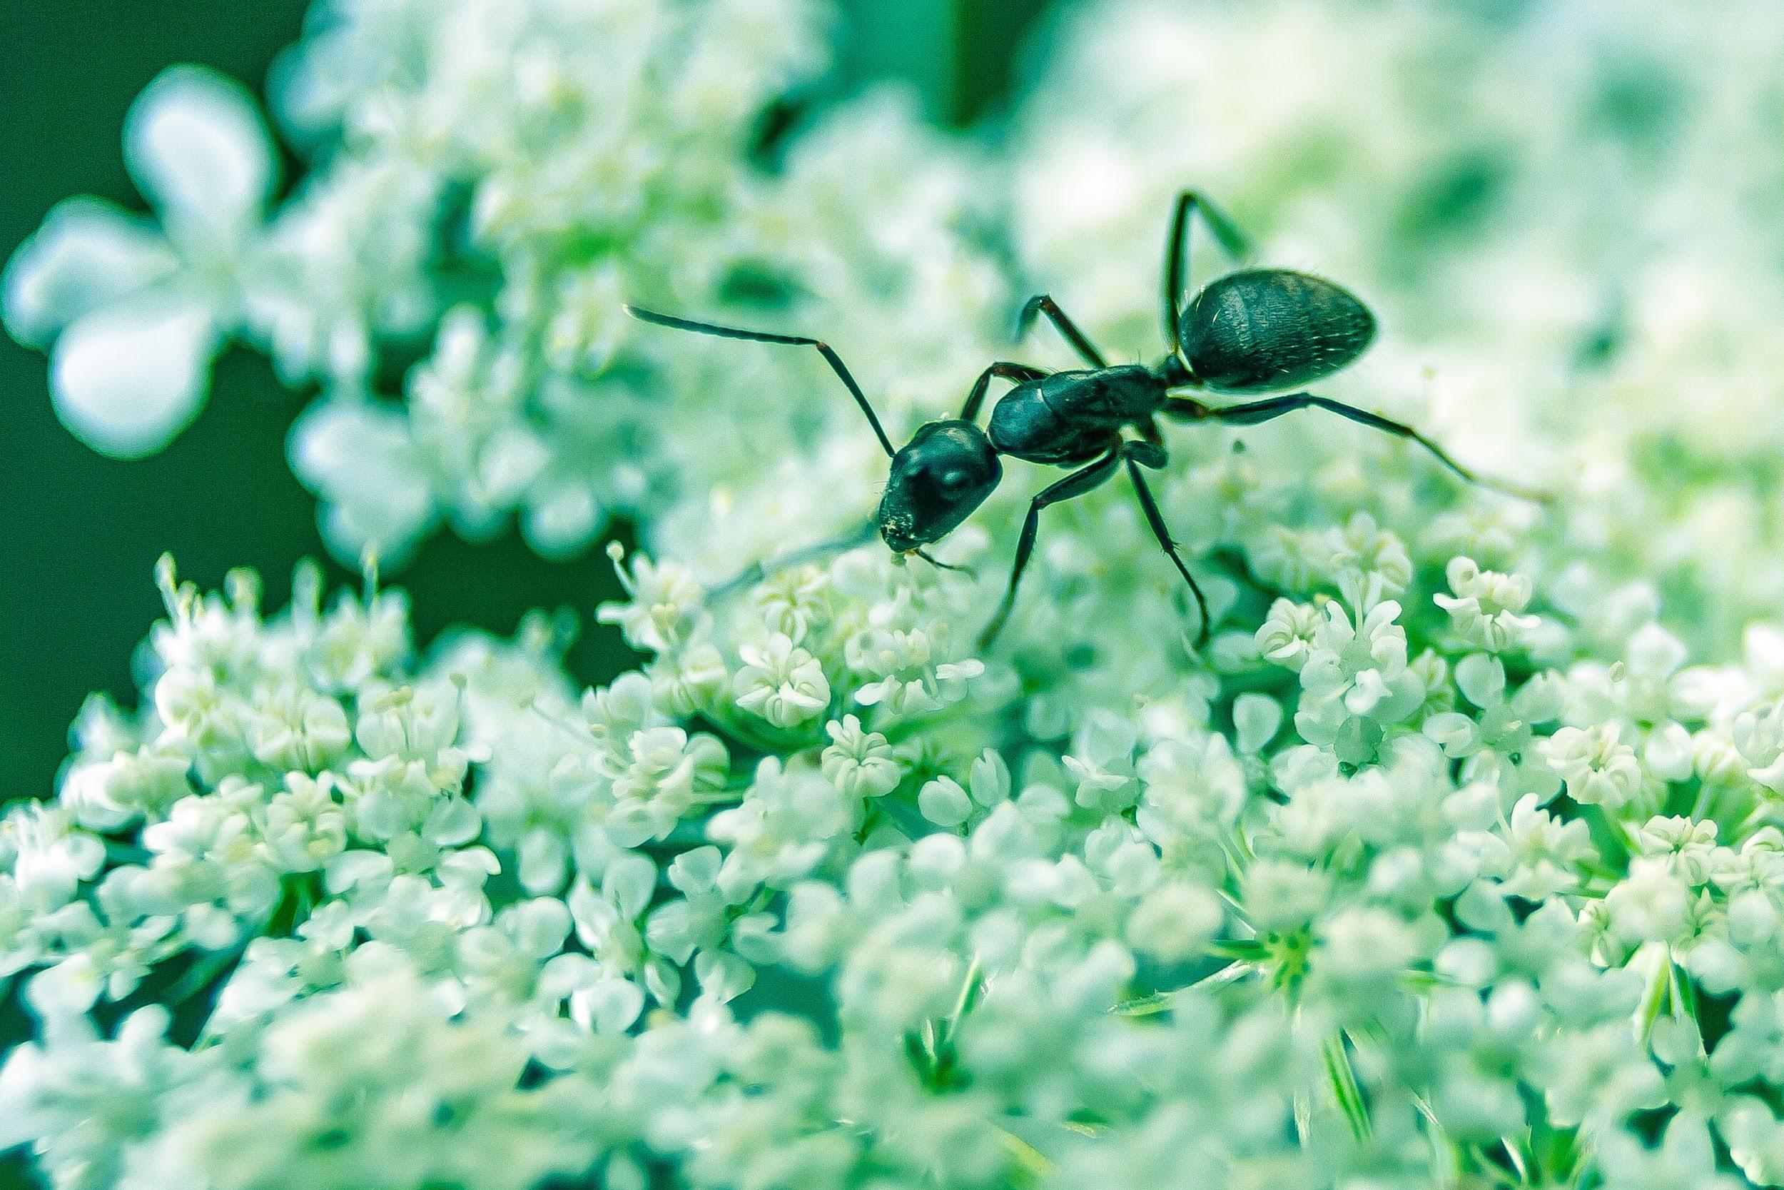
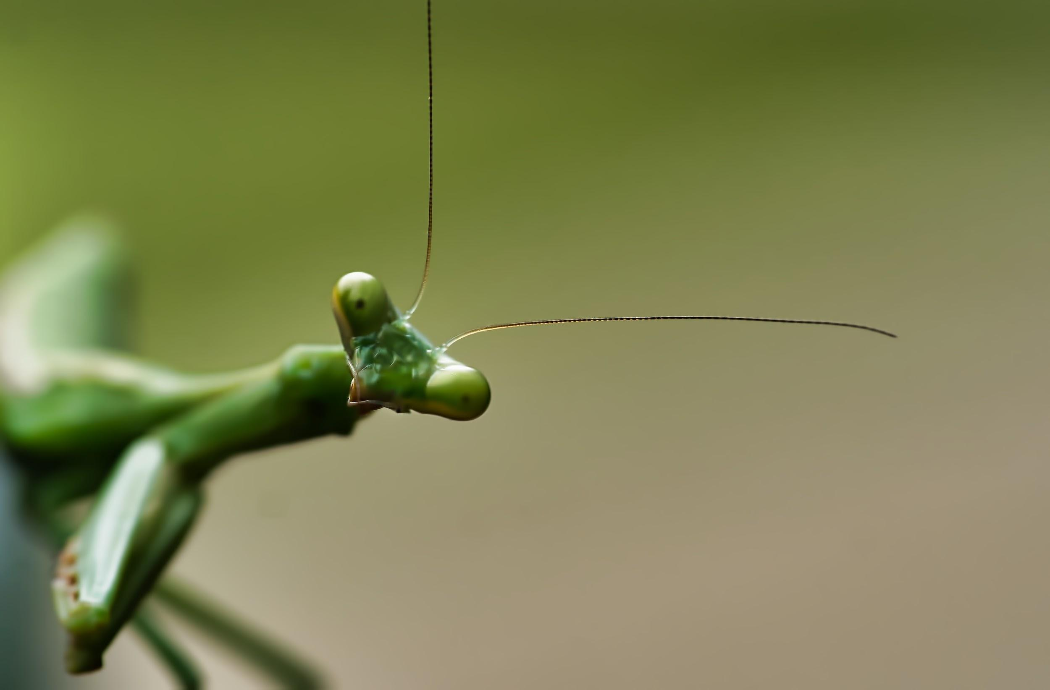
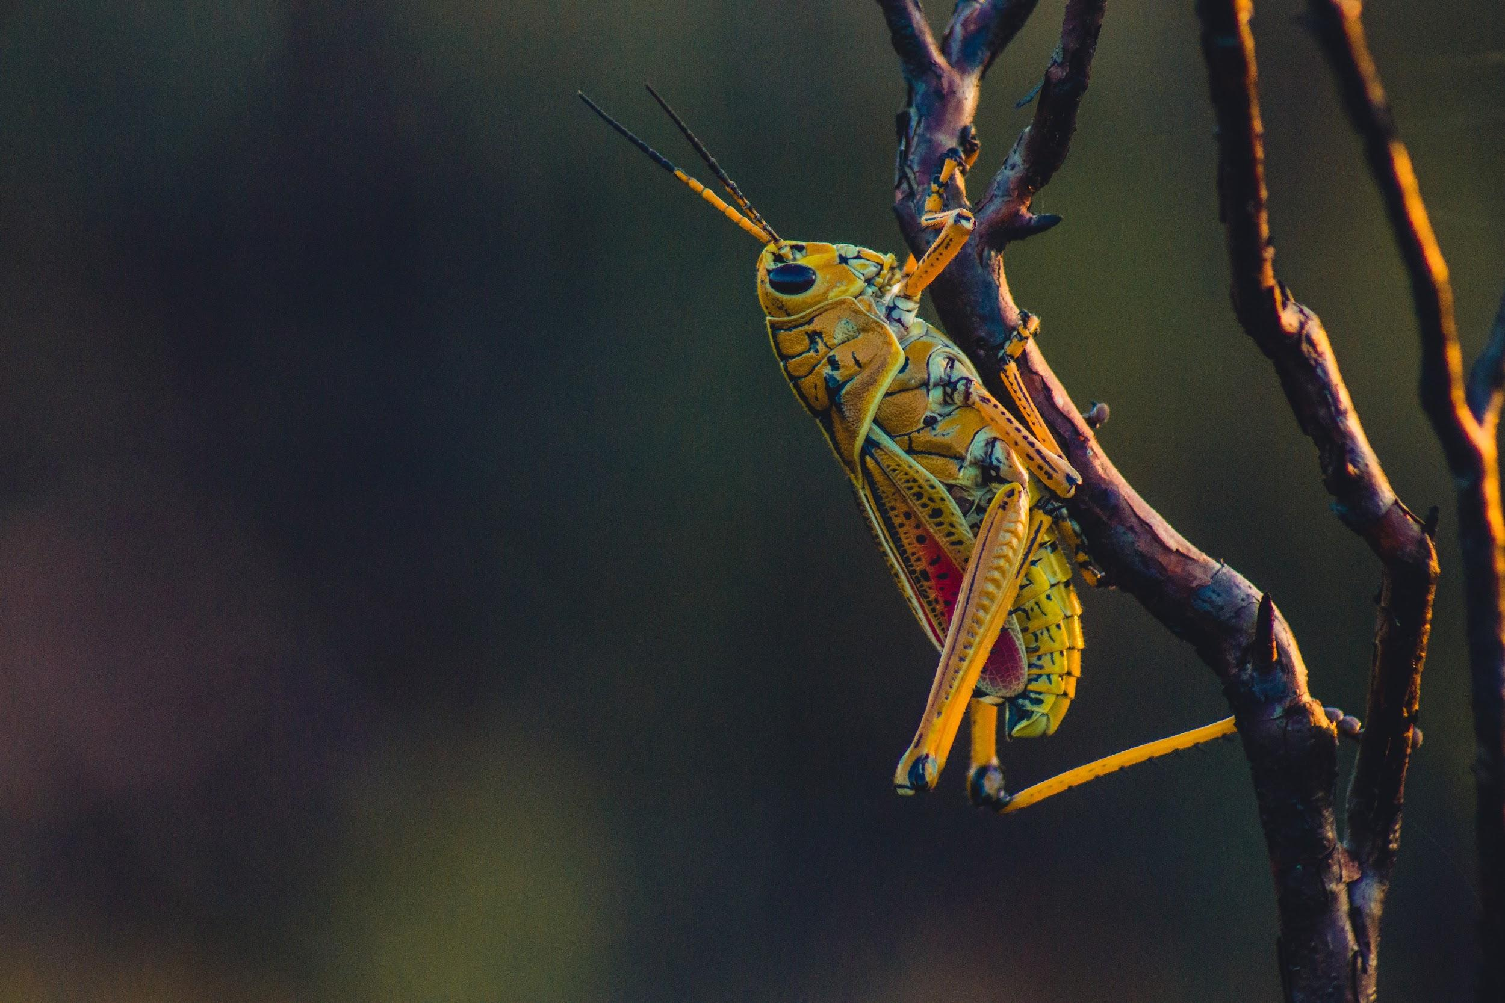
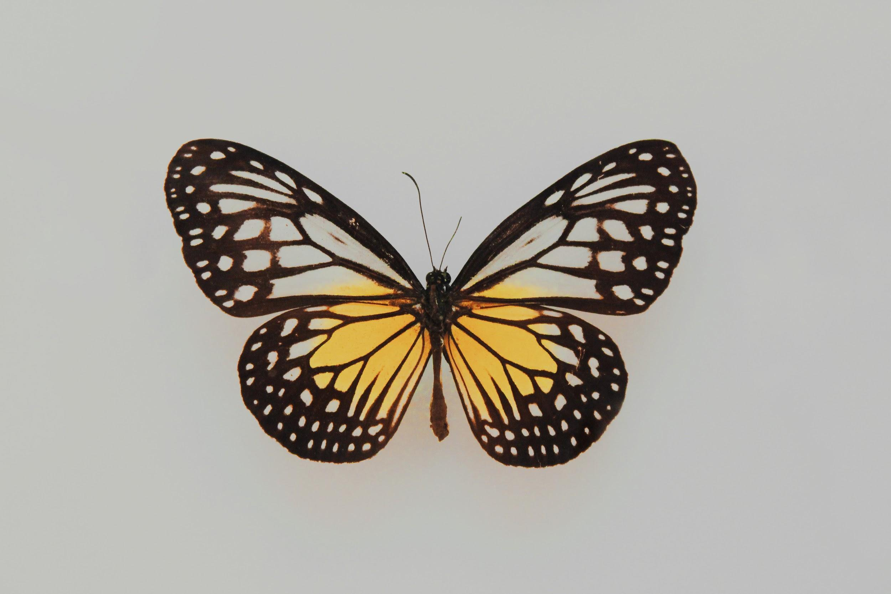
We will classify organisms using tabular keys.
CHECK FOR UNDERSTANDING
Use the table below to identify: Caterpillar - Grasshopper Ant - Butterfly - Mantis
Use the dichotomous key below to create a tabular key.
1 | Has Small Antennae₁ Has No Small Antennae | ________ Go To 2
2 | Has _______________ Has No ____________ | ________ Go To 3
3 | Can _______________ Cannot ____________ | ________ Go to 4
4 | Does ______________ Does Not ___________ | ________ ________
VOCABULARY
1 - long appendages on insect heads

Slide 14
We will use the Linnaean classification system to compare organisms.
TRACK WITH ME
READ WITH ME
We will consider how classification systems have changed over time.
We will describe the Linnaean classification system.
We will list the levels of the Linnaean classification system.
We will use examples of organisms to compare based on the Linnaean classification system.
DECLARE THE OBJECTIVE
Read the learning objective to your partner.
Notes:
Learning Objectives contain concepts (nouns, big ideas), skills (verbs, measurable behaviours) and sometimes context (restricting or targeting conditions).
●Example: Students will be able to describe the concept of density and apply it to floating and sinking.
●
Success criteria are specific measurable outcomes that if met mean that the student has met the learning objective.
Examples:
•Students will be able to compare densities of substances using mass and volume.
•Students will be able to identify whether a solid or liquid will float or sink in a liquid based on their densities.

Slide 15
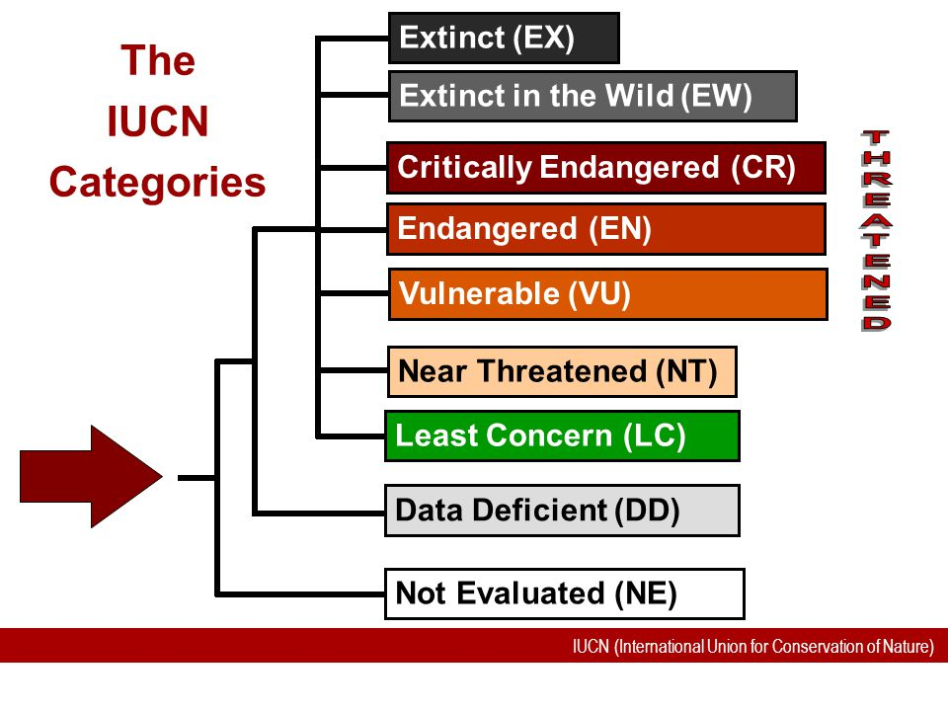
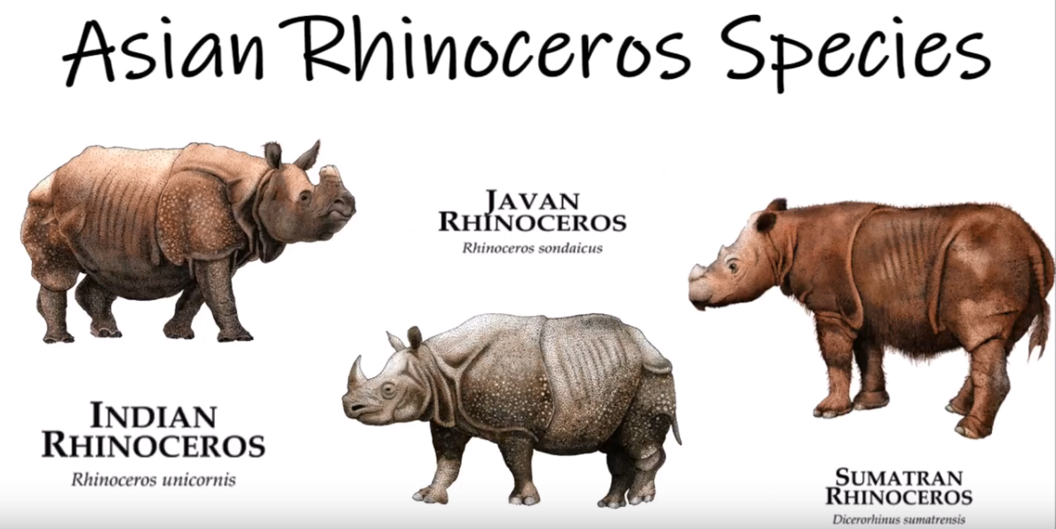
We will use the Linnaean classification system to compare organisms.
CHECK FOR UNDERSTANDING
Why is it important for scientists to classify organisms? Explain
Classification is a system of sorting organisms₁ such as plants and animals into different groups based on observable₂ features.
Scientists classify organisms for the following reasons:
Organisation
Identification
Communication
VOCABULARY
1 - Living things 2 - What they look like
All names start with Rhinoceros

Slide 16
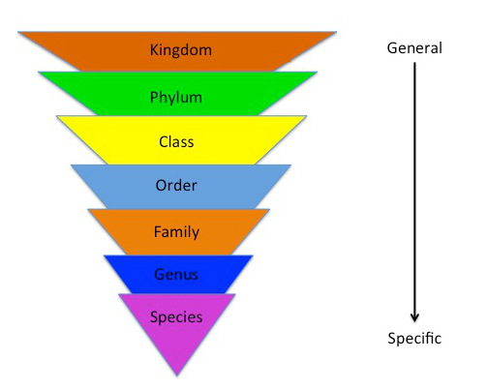
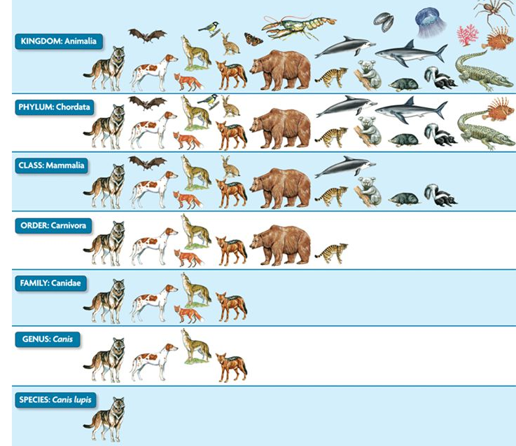
We will use the Linnaean classification system to compare organisms.
CHECK FOR UNDERSTANDING
In which level of classification are organisms most alike?
In 1735 a scientist called Carl Linnaeus published a system for classifying living things.
His classification system was based on the morphological₁ characteristics of the organism. Organisms that looked most alike were grouped closest together.
His classification system had seven levels:
Kingdom
Phylum
Class
Order
Family
Genus
Species
More alike
VOCABULARY
1 - observable = what something looks like.

Slide 17

We will use the Linnaean classification system to compare organisms.
CHECK FOR UNDERSTANDING
Can you make up your own mnemonic to help you remember? K P C O F G S
The seven levels of classification can be remembered using the mnemonic:
King | Kingdom
Phillip | Phylum
Came | Class
Over | Order
For | Family
Good | Genus
Spaghetti | Species
More alike
VOCABULARY
1 - observable = what something looks like.

Slide 18
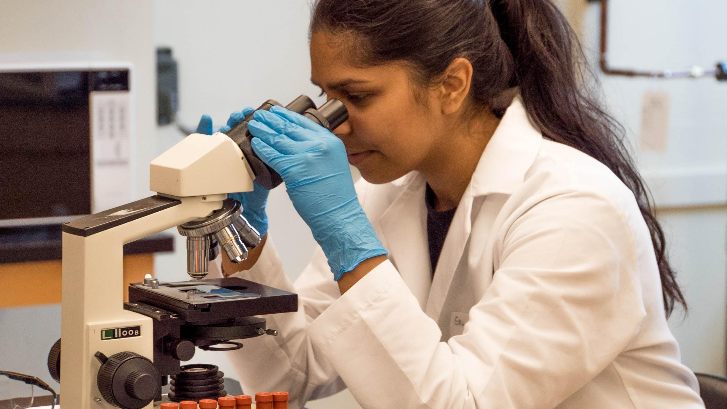
We will use the Linnaean classification system to compare organisms.
CHECK FOR UNDERSTANDING
Why do you think Linneas only described plants and animals?
When Linnaeus first described his system in 1735, he only had two kingdoms – Animals and Plants.
Today, scientists think there are at least five kingdoms:
Animals
Plants
Fungi - considered plants by Linnaeas.
Protists (very simple organisms made up of one cell)
Monera (bacteria, also single celled organisms)
Single celled organisms can only be viewed with a microscope. Microscopes became a common piece of scientific equipment after the 1850s.
EXTENSION
In 1676 Antonie Van Leeuwenhoek wrote to the Royal Society of London about his discovery of microscopic single celled organisms using a microscope. At first, the Royal Society doubted Van Leeuwenhoek's findings until he convinced the Royal Society to test his results. They spent time testing his findings and eventually supported them.

Slide 19
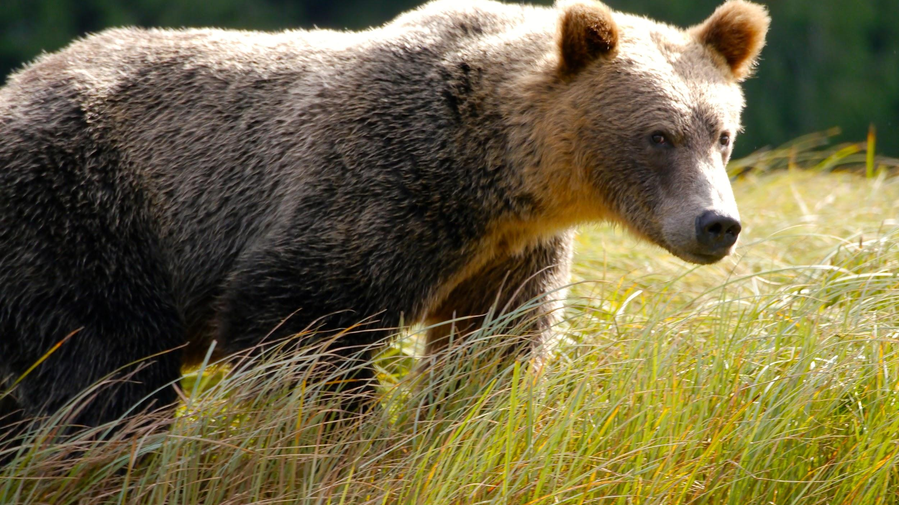
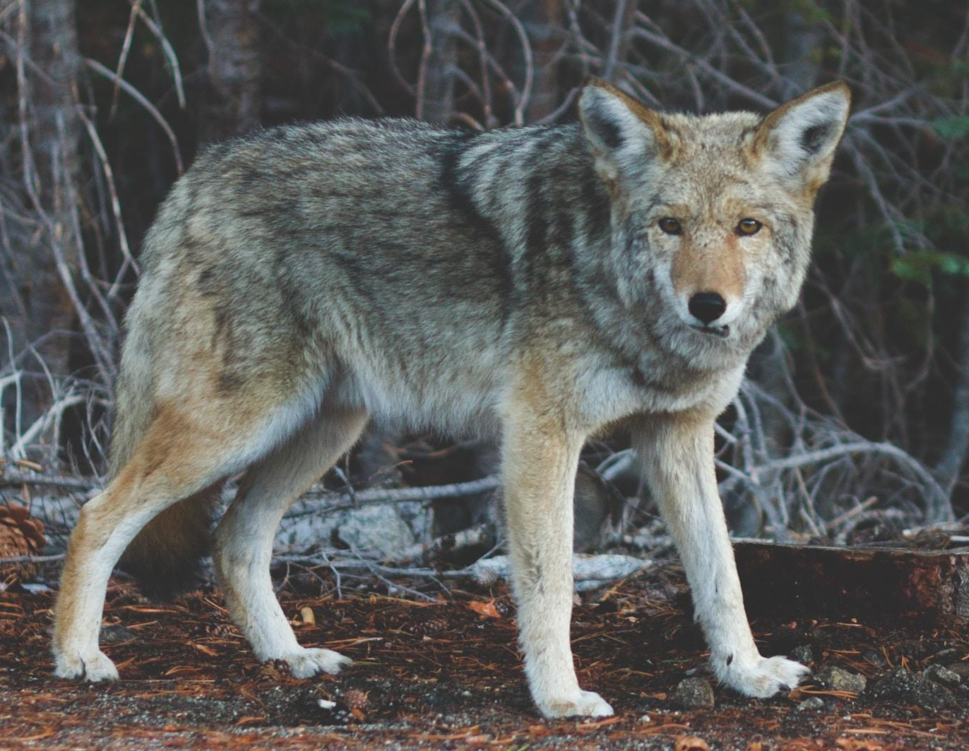
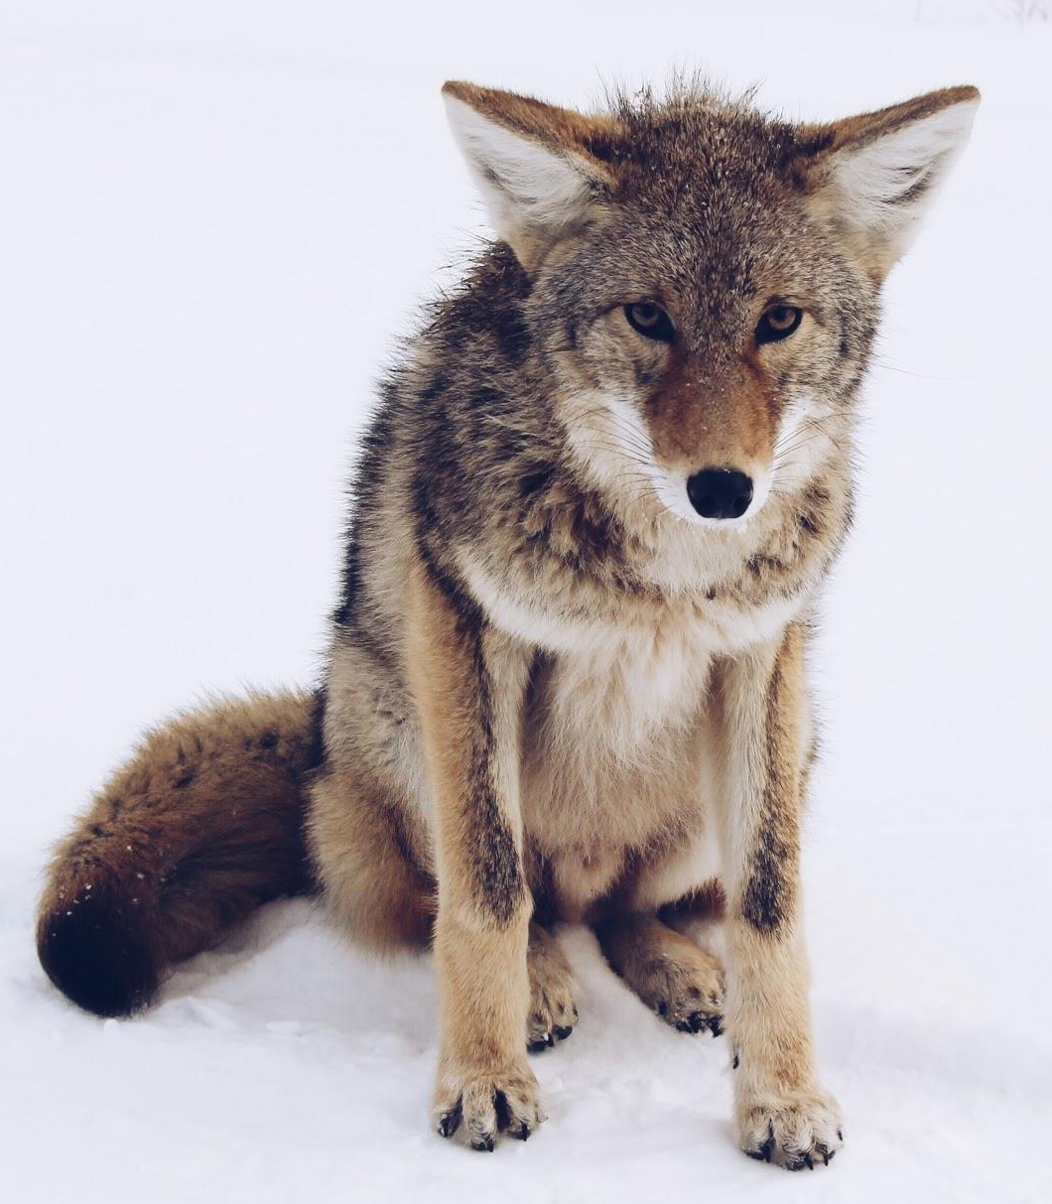
We will use the Linnaean classification system to compare organisms.
CHECK FOR UNDERSTANDING
Which two organisms are more closely related? Grizzly Bear & Wolf Grizzly Bear & Coyote Wolf & Coyote
Carl Linnaeus also developed a hierarchal₁ naming structure. Organisms that have more classification levels in common are more closely related.
Example | Grizzly Bear | Wolf | Coyote
Kingdom | Animalia | Animalia | Animalia
Phylum | Chordata | Chordata | Chordata
Class | Mammalia | Mammalia | Mammalia
Order | Carnivora | Carnivora | Carnivora
Family | Ursidae | Canidae | Canidae
Genus | Ursus | Canis | Canis
Species | Ursus arctos | Canis lupis | Canis latrans
VOCABULARY
1 - arranged in order of importance/rank.

Slide 20
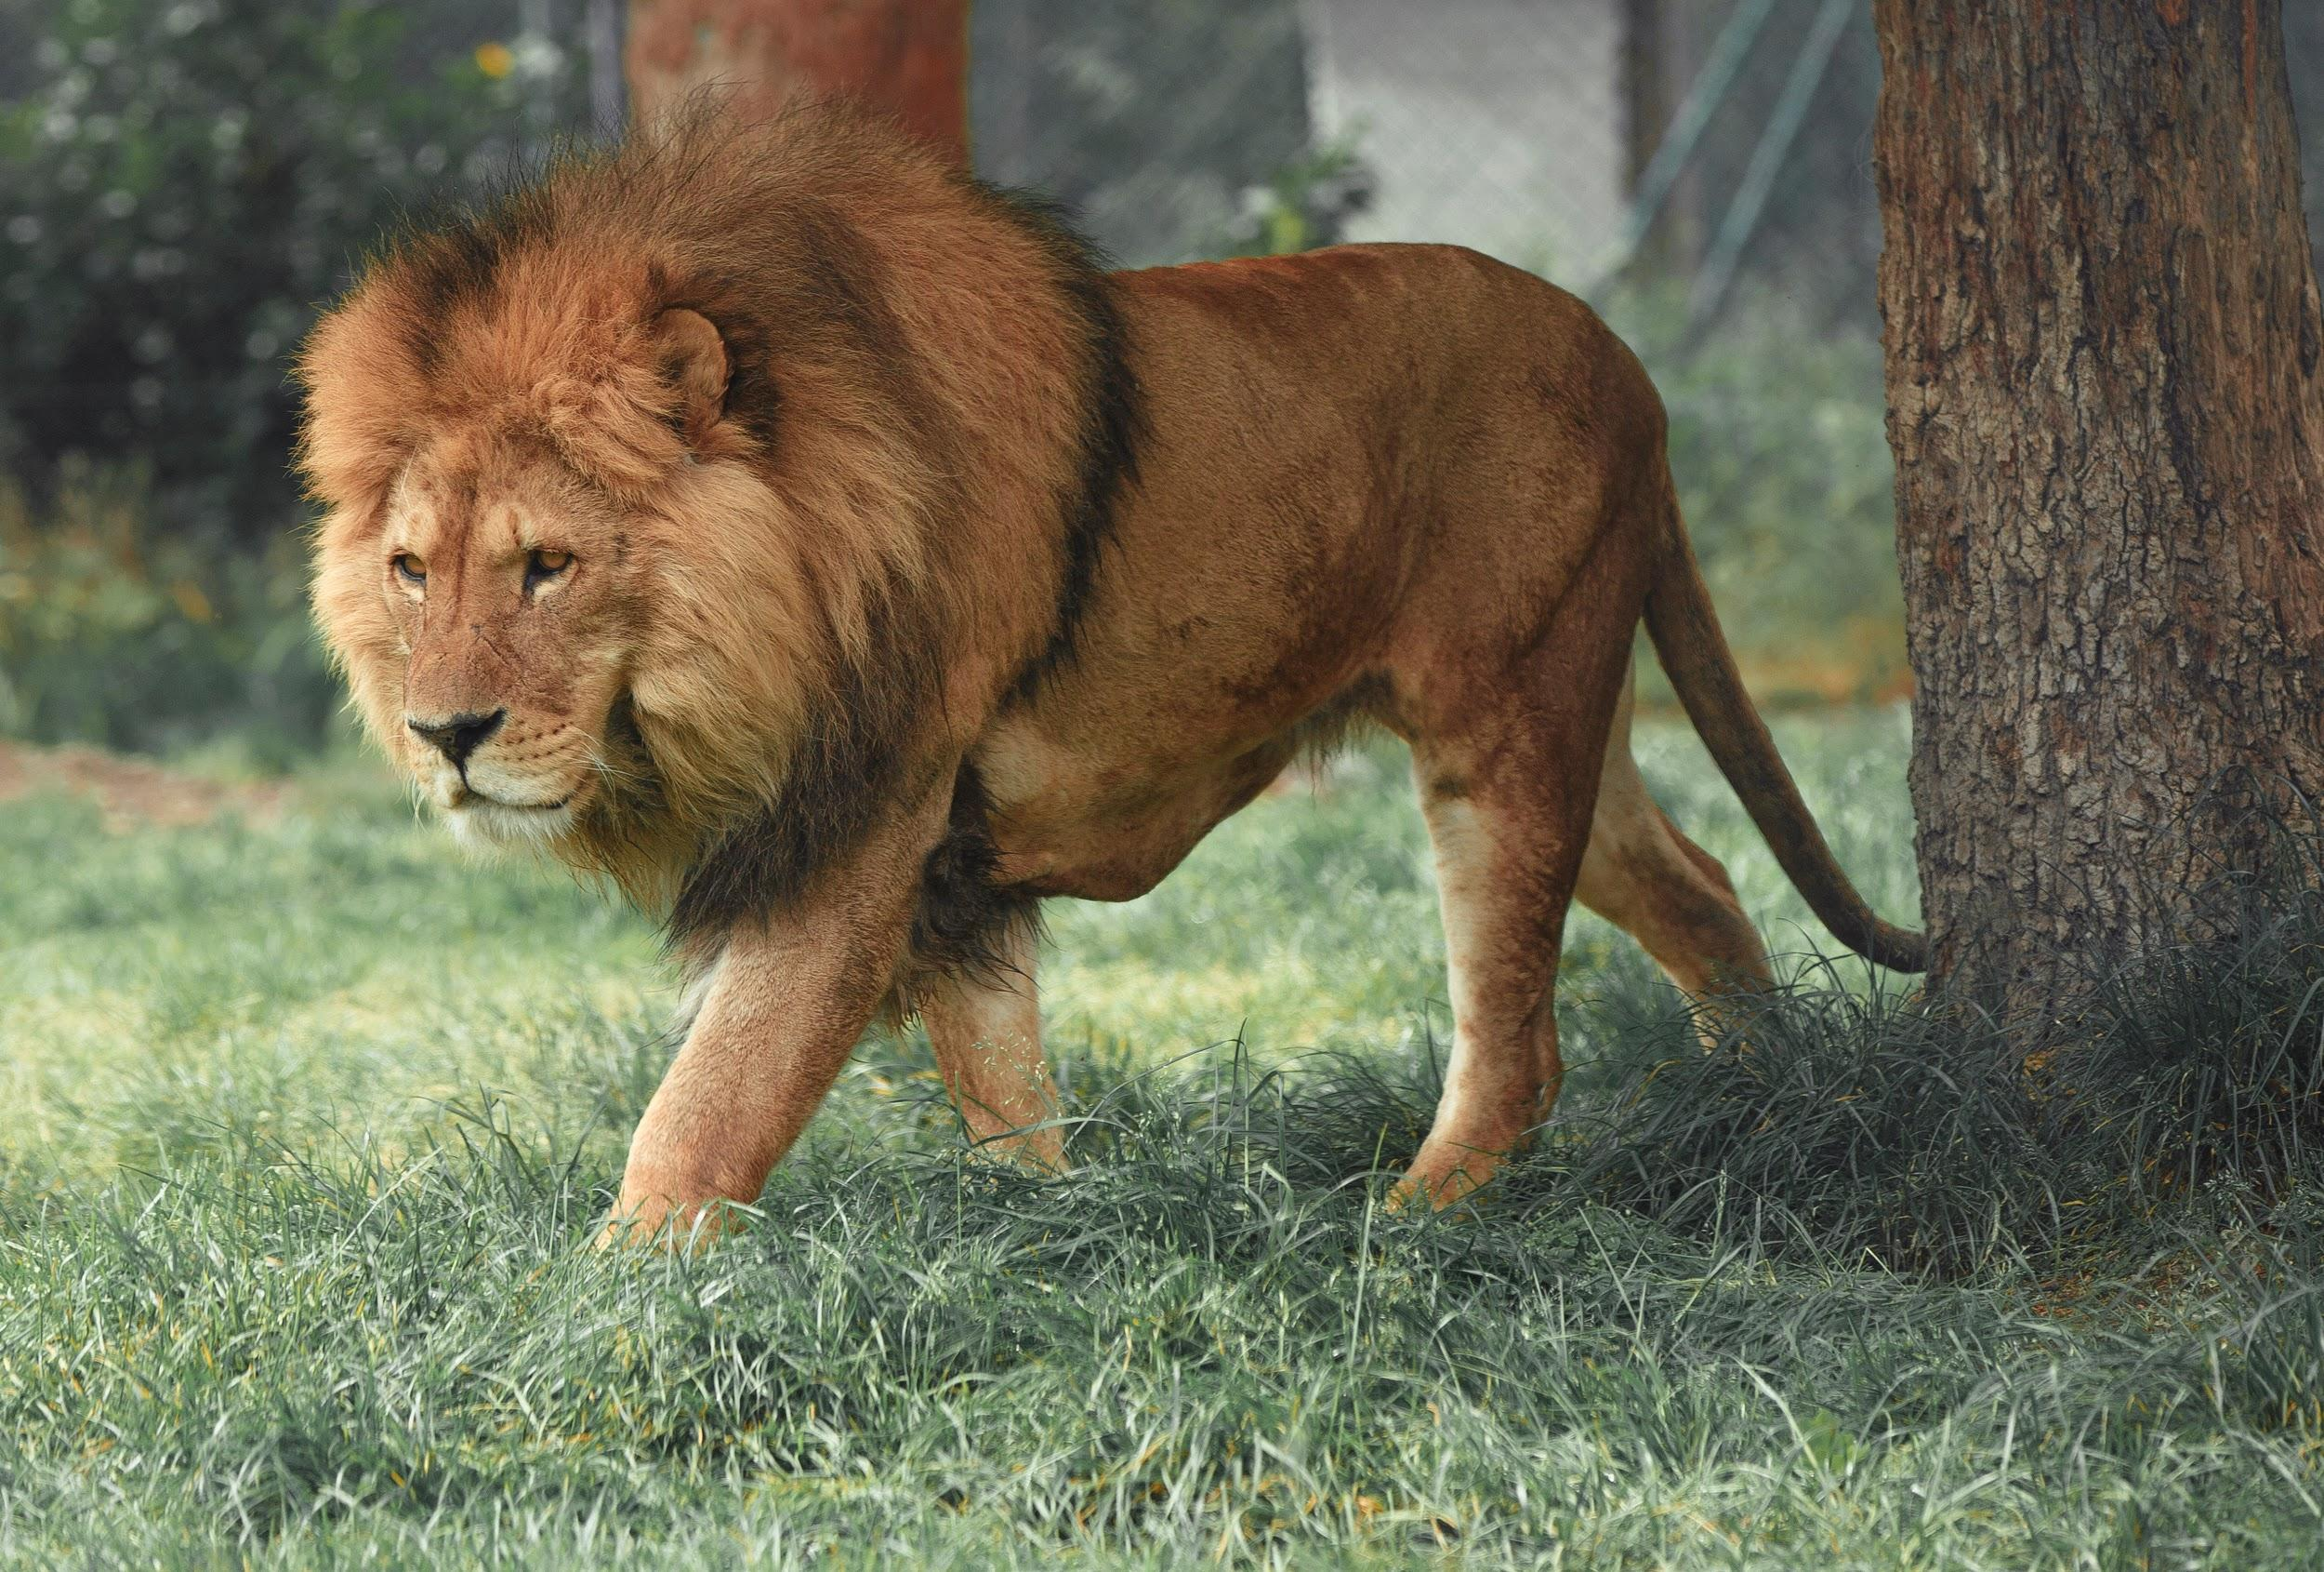
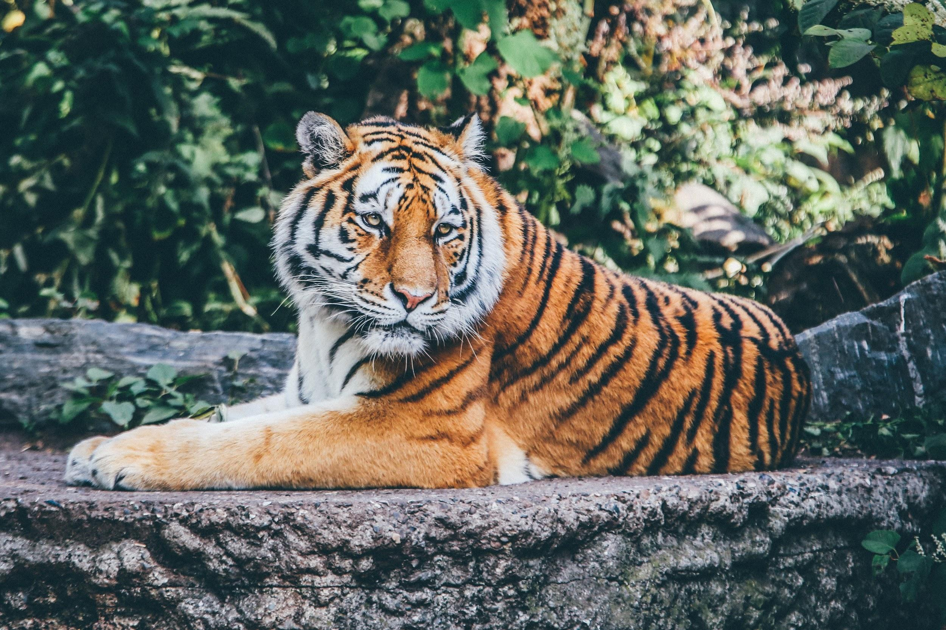
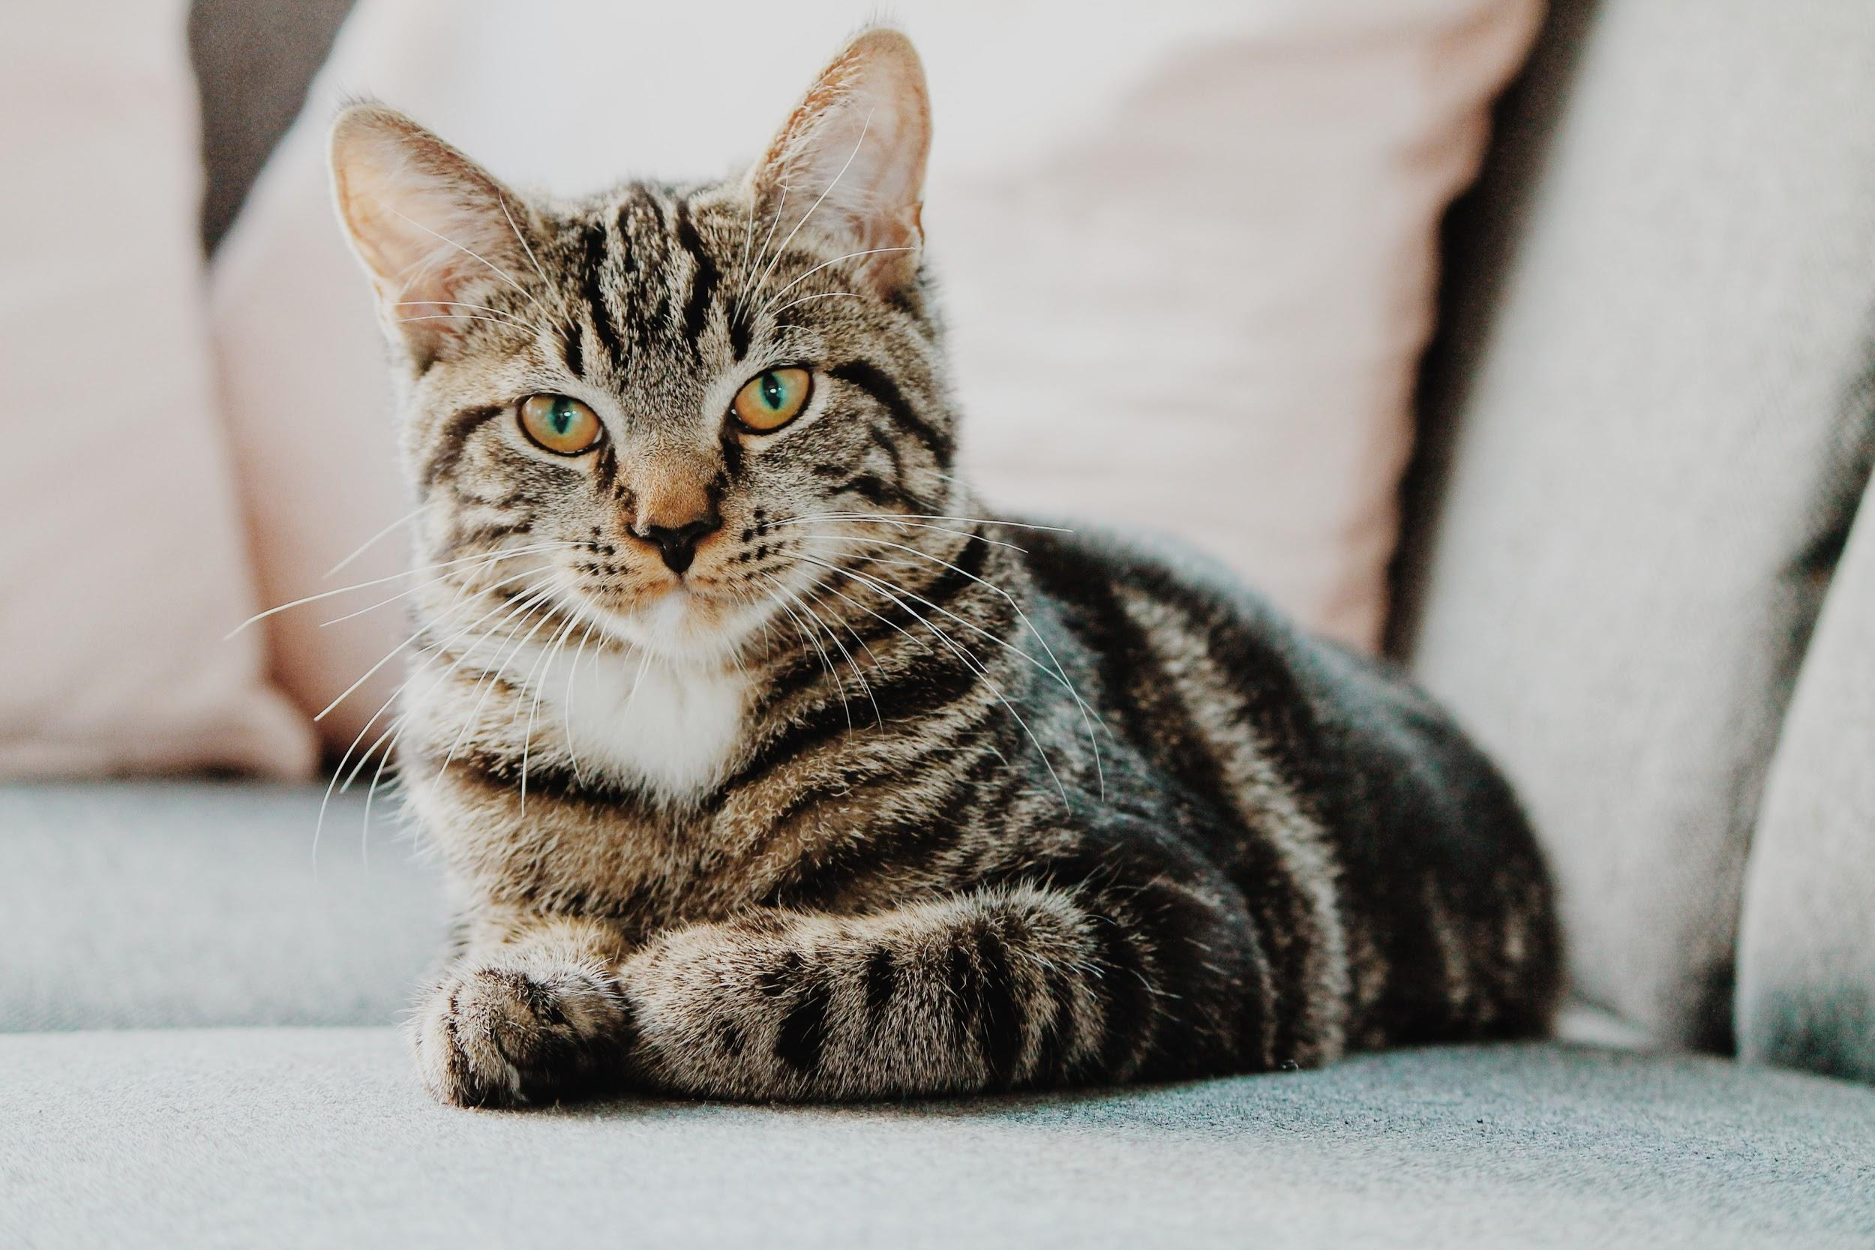
We will use the Linnaean classification system to compare organisms.
CHECK FOR UNDERSTANDING
Which two organisms are more closely related? Lion & Tiger Lion & Cat Tiger & Cat
The more classification levels the organisms have in common the more closely related they are, and the more similar they will look.
Example | Lion | Tiger | Cat
Kingdom | Animalia | Animalia | Animalia
Phylum | Chordata | Chordata | Chordata
Class | Mammalia | Mammalia | Mammalia
Order | Carnivora | Carnivora | Carnivora
Family | Felidae | Felidae | Felidae
Genus | Panthera | Panthera | Felis
Species | Panthera leo | Panthera tigris | Felis catus

Slide 21
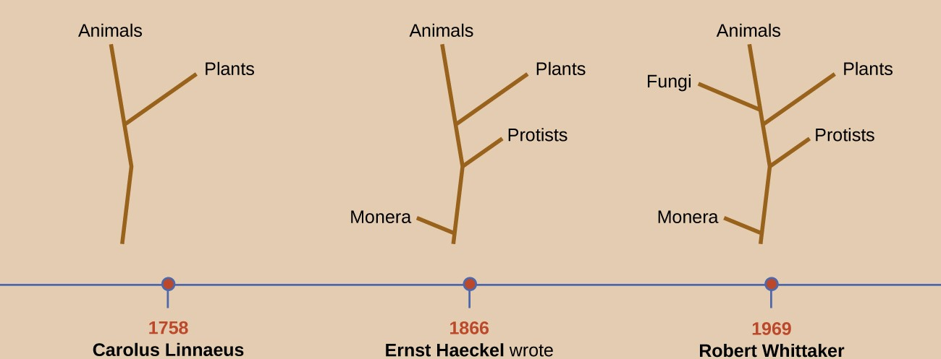
We will use the Linnaean classification system to compare organisms.
CHECK FOR UNDERSTANDING
How did the classification of organisms change between 1735 and 1969?
In 1866, Ernst Haeckel (a German biologist, philosopher, and physician) proposed adding a third kingdom Protists, for single celled organisms.
Haeckel later proposed adding a fourth kingdom, Monera, for single celled organisms whose cells lack nuclei, like bacteria.
Nearly 100 years later, in 1969, Robert Whittaker (an American ecologist) proposed adding a fifth kingdom, Fungi.

Slide 22
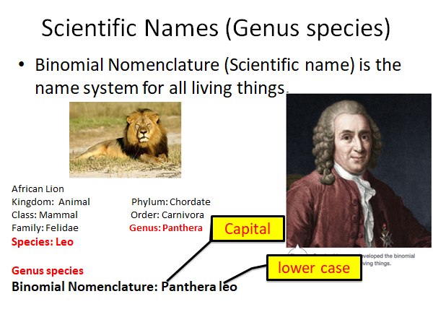
We will explain why we classify organisms.

Slide 23
We will use the Linnaean classification system to compare organisms.
Put the levels of classification into order using numbers 1 - 7.
HINT
King KINGDOM Phillip PHYLUM Came CLASS Over ORDER For FAMILY Good GENUS Spaghetti SPECIES
NUMBER | A: Lion | B: Tiger | C: Grizzly Bear | D: Wolf
1 | S: Panthera leo | K: Animalia | O: Carnivora | S: Canis lupis
2 | P: Chordata | F: Felidae | G: Ursus | P: Chordata
3 | K: Animalia | G: Panthera | C: Mammalia | K: Animalia
4 | O: Carnivora | O: Carnivora | S: Ursus arctos | F: Canidae
5 | C: Mammalia | C: Mammalia | F: Ursidae | O: Carnivora
6 | G: Panthera | P: Chordata | K: Animalia | G: Canis
7 | F: Felidae | S: Panthera tigris | P: Chordata | C: Mammalia
TEACHER CUE
Do example A and possibly B with students. A: 3, 2, 5, 4, 7, 6, 1.
Notes:
C has two lots of Kingdom - Is missing order

Slide 24
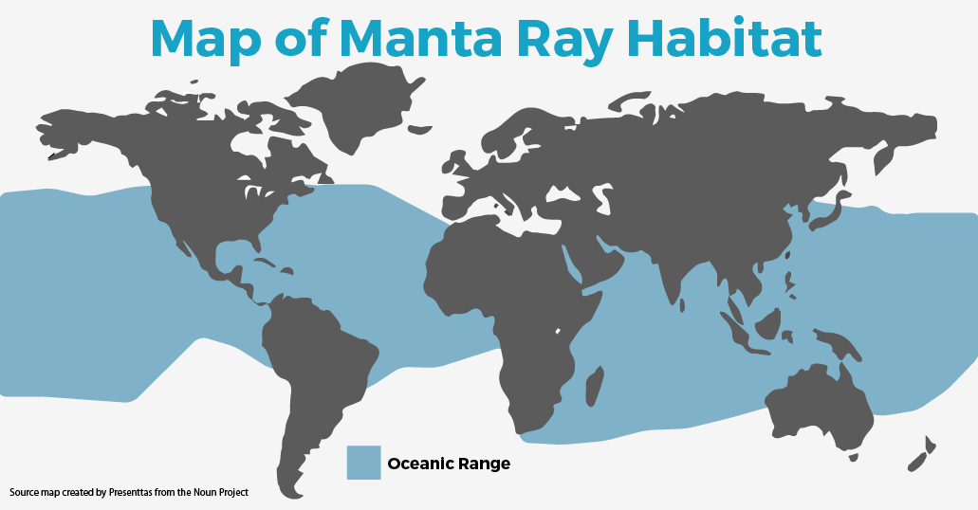
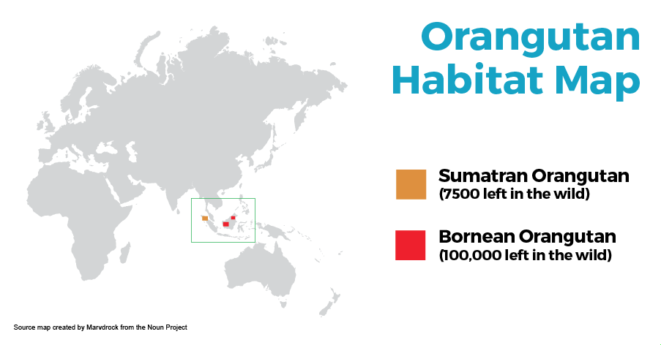
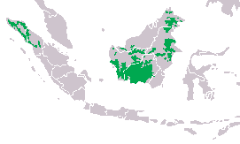
We will use the Linnaean classification system to compare organisms.
Scientists use the Linnaean classification system to sort organisms into different groups. This helps them to communicate clearly with other scientists around the world about:
discovering and naming new organisms.
identifying animals conservation status (e.g. not threatened, endangered).
new information on different organisms (diet, breeding, habitat, behaviour, population, etc.).
identifying any changes in the habitat range of different organisms (often due to human impacts such as deforestation).
setting up conservation programs and other important tasks.
CHECK FOR UNDERSTANDING
Why is classification important?

Slide 25
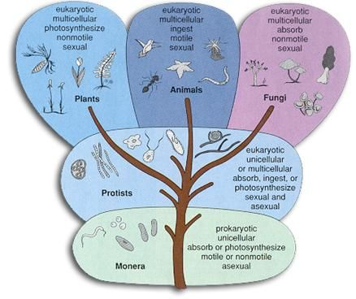
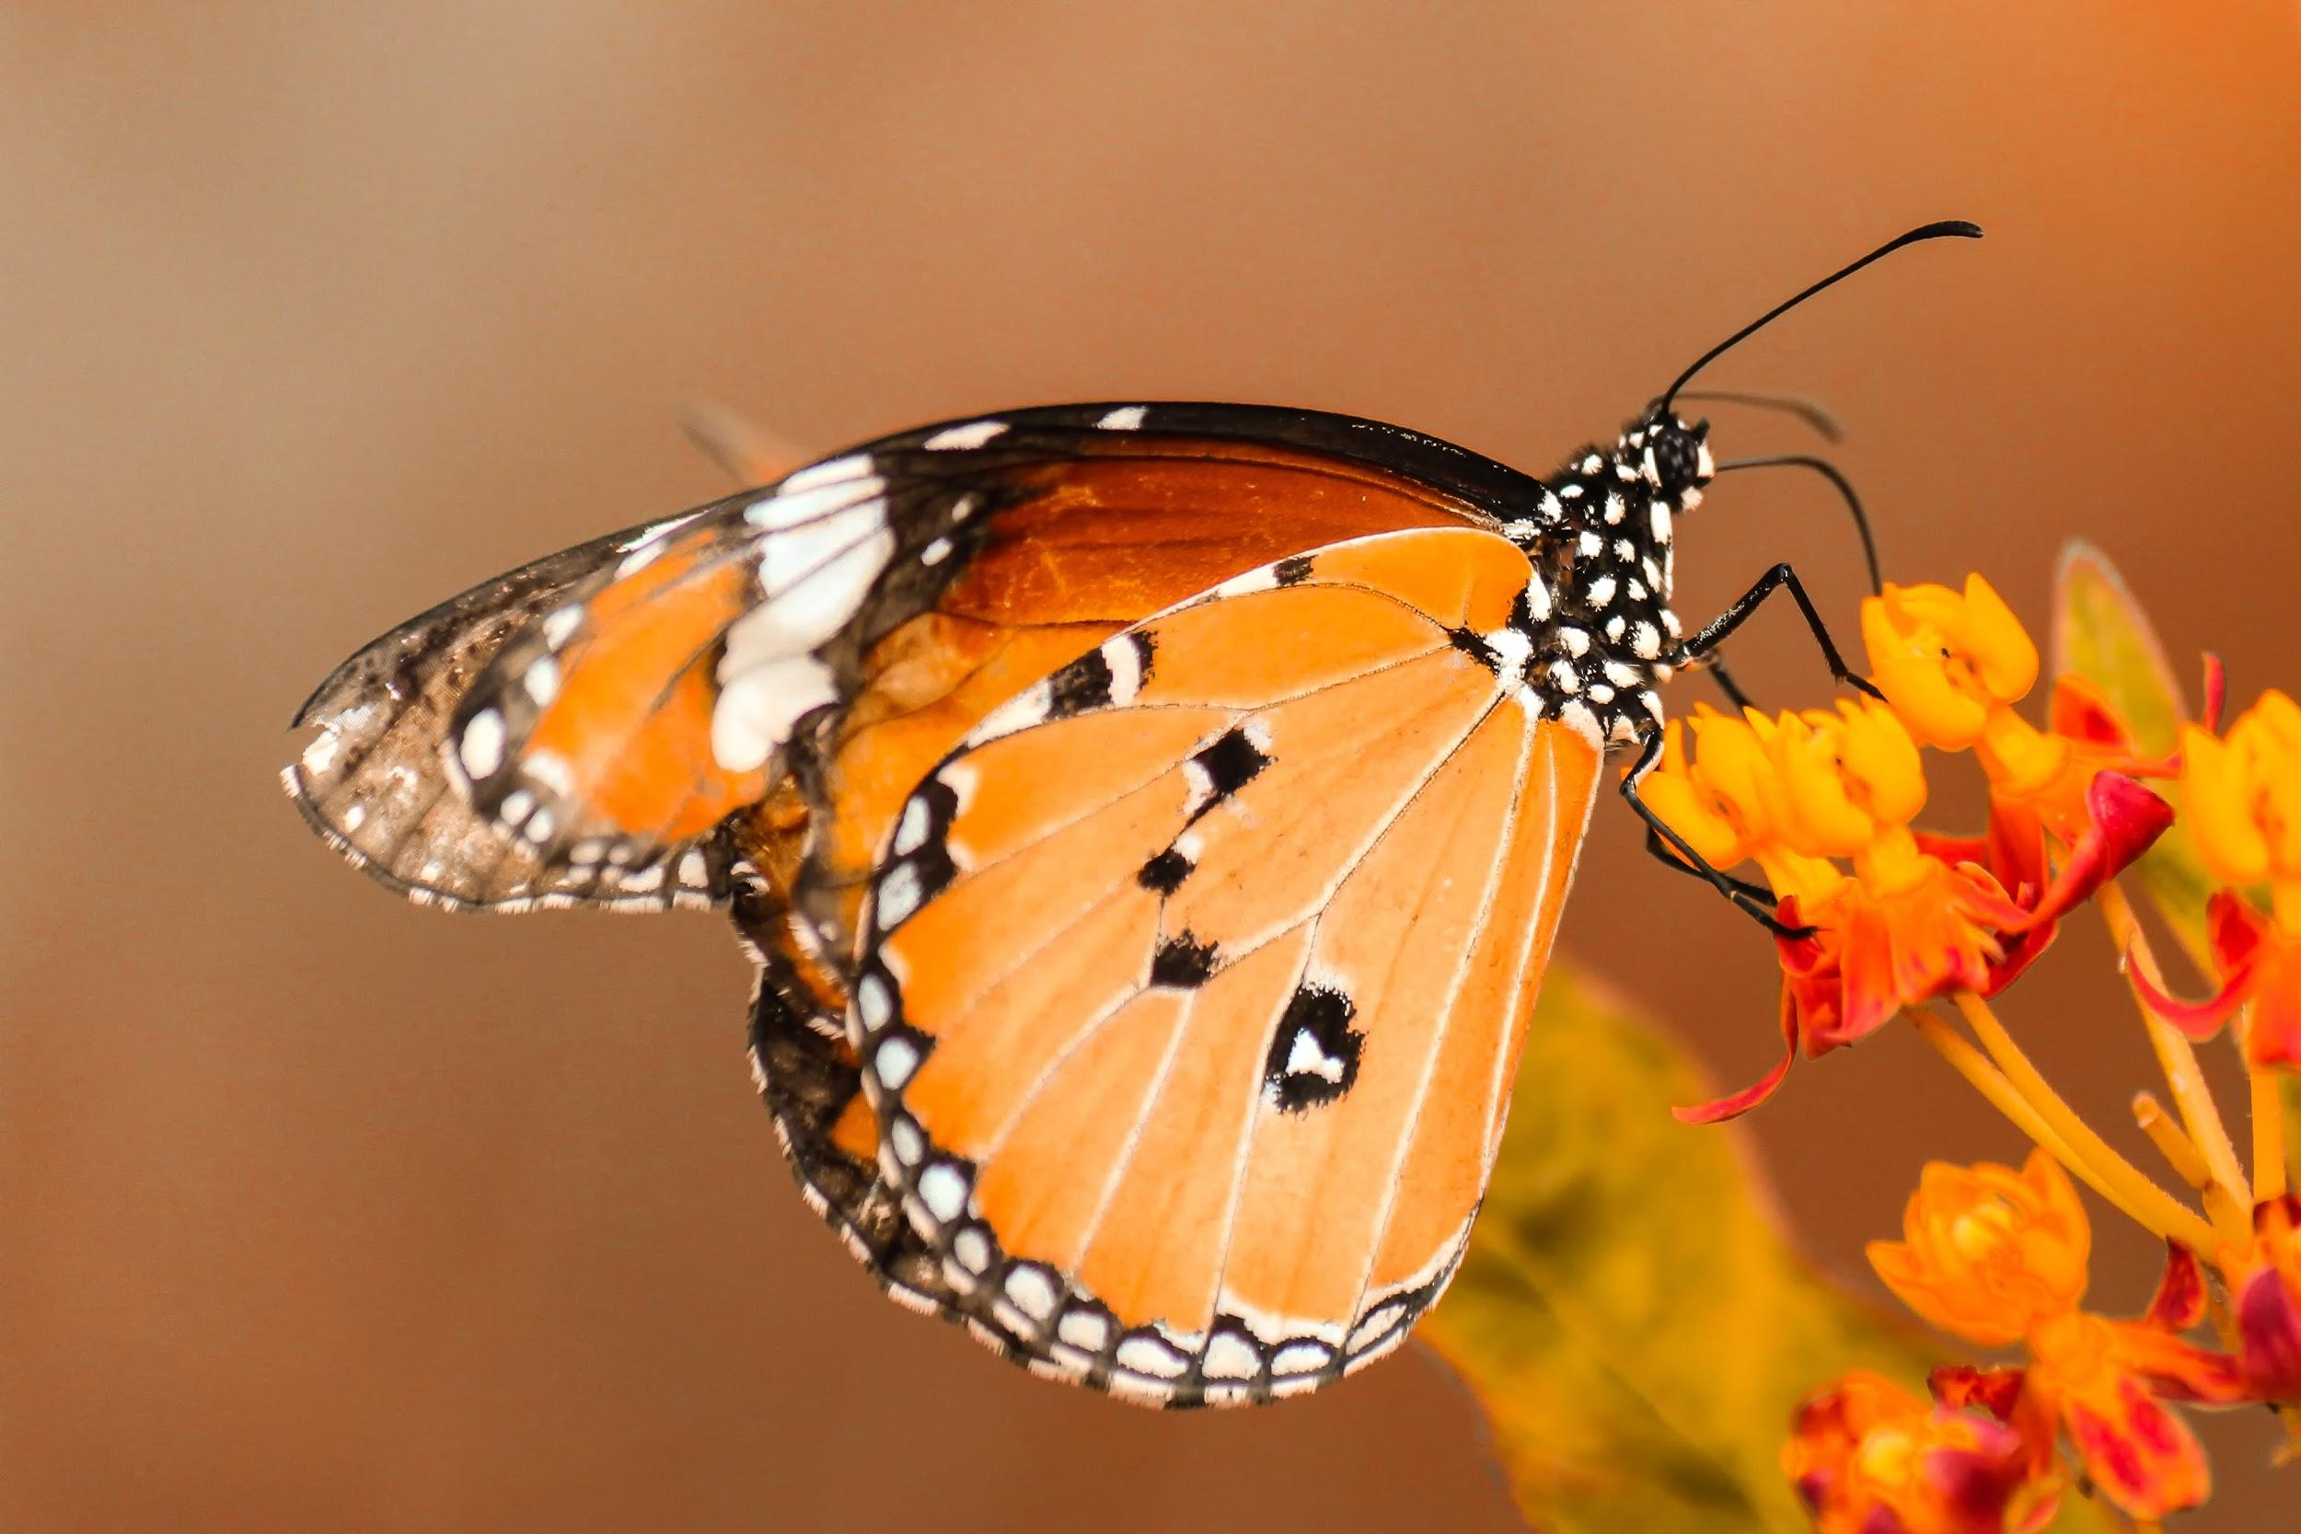
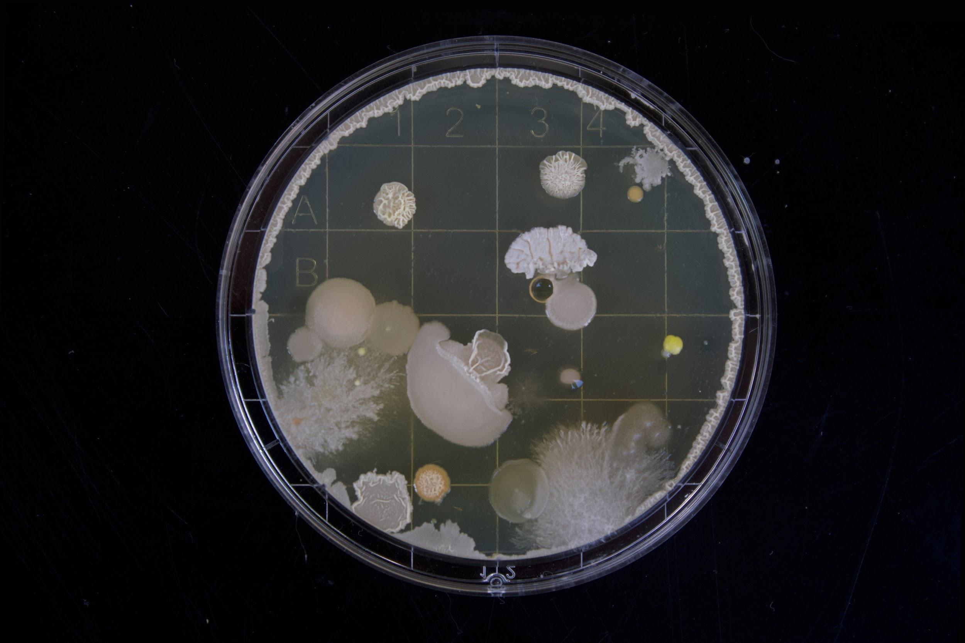
We will use the Linnaean classification system to compare organisms.
Classification is a system of sorting organisms into groups based on observable features.
The Linnaean classification system has seven levels:
Kingdom
Phylum
Class
Order
Family
Genus
Species
The more classification levels the organisms have in common the more closely related they are, and the more similar they will look.
CHECK FOR UNDERSTANDING
There are five kingdoms, Animals, Plants, Fungi, Protists and Monera (bacteria). Would Animals and Monera (bateria) be closely related? Explain

Slide 26
We will use the Linnaean classification system to compare organisms.
Organise these organisms from most closely to least closely related to humans.
Example | Human | Bottlenose Dolphin | Bobtail Lizard | Chimpanzee | Sponge
Kingdom | Animalia | Animalia | Animalia | Animalia | Animalia
Phylum | Chordata | Chordata | Chordata | Chordata | Porifera
Class | Mammalia | Mammalia | Reptilia | Mammalia | Demospongiae
Order | Primates | Artiodactyla | Squamata | Primates | Haplosclerida
Family | Hominidae | Delphinidae | Scincidae | Hominidae | Niphatidae
Genus | Homo | Tursiops | Tiliqua | Pan | Amphimedon
Species | Homo sapiens | Tursiops osennae | Tiliqua rugosa | Pan troglodytes | Amphimedon queenslandica
Notes:
Please include tasks/questions here rather than just referring to a worksheet. This will save on photocopying and facilitate sharing with other schools.
Try and build tasks/questions which escalate through Bloom’s Taxonomy. This will help with differentiation.

Slide 27
We will use the Linnaean classification system to compare organisms.
We will consider how classification systems have changed over time.
We will describe the Linnaean classification system.
We will list the levels of the Linnaean classification system.
We will use examples of organisms to compare based on the Linnaean classification system.
CHECK FOR UNDERSTANDING
Check Success Criteria.

